Slide 1




Xamarin training
for mobile app development professionals
FUNdamentals

Slide 2
Agenda
Asynchronous programming
Architectural design
Business requirements drive architecture
Networking best practices
Architectural patterns
Local storage
Storage architecture
Custom views
Linking
Troubleshooting and code reviews
Memory management
Profiling
Performance

Slide 3
Let’s start here: a primer on asynchronous programming

Slide 4



Why asynchronous programming?
Asynchronous programming allows our mobile apps to continue to respond to user interaction while doing something else
Reading or writing to a database or file
Accessing a web service
Performing data processing
Notes:
We're going to be talking about "asynchronous programming" and it might help to define what that actually means.
Synchronous means perform something here and now and I will regain control to execute something else when it’s done.
Asynchronous means initiate something here and now and I will regain control to execute something else “immediately”.
The primary goal for asynchronous programming in mobile apps is to ensure that our applications continue to be responsive to the user while still allowing the application to do other activities behind the scenes.
[Next]
These other activities might be I/O related such as reading or writing to a file or database.
[Next]
Or using network services to retrieve information from a web service.
[Next]
Or, these activities might be background operations which require the use of a background thread to perform some data processing.

Slide 5
The problem with asynchronous programming
Prior to .NET 4.5, async programming was done through callbacks that forced developers to write code in a non-linear fashion
void OnReadDataFromUrl(object sender, EventArgs e) { WebClient wc = new WebClient(); wc.DownloadDataCompleted += (sender, e) => { if (e.Error == null) { var data = Encoding.GetString(e.Result); LoadData(data); } }; wc.DownloadDataAsync(new Uri(url.Text)); }
How readable is this code
Notes:
Q: Can you see a possible race condition in order of operation?
A: Event Handler not being assigned if after DownloadDataAsync call
Here's a similar method to the one we just looked at. Let's look at some of the issues async programming often causes in our code. Here's a basic example. We are using WebClient to retrieve some data from a web service using the event style.
[Next]
Q: What do you think of this code?
How quickly can your brain "parse" it and determine what it's doing?

Slide 6
The problem with async programming
Prior to .NET 4.5, async programming was done through callbacks that forced developers to write code in a non-linear fashion
Processing code is defined separately
void OnReadDataFromUrl(object sender, EventArgs e) { WebClient wc = new WebClient(); wc.DownloadDataCompleted += (sender, e) => { if (e.Error == null) { var data = Encoding.GetString(e.Result); LoadData(data); } }; wc.DownloadDataAsync(new Uri(url.Text)); }
Notes:
For most people, the answer is "gross". And for good reason —
> The processing logic is defined separately and out of scope from the initiating function.
> Ordering is important – we have to wire up the Completed function first – otherwise we introduce a potential race condition.
> Lambdas and anonymous methods made this a little easier to work with, but it's still harder to understand.
> The processing code is not executed until the async operation is complete.

Slide 7
The problem with async programming
Prior to .NET 4.5, async programming was done through callbacks that forced developers to write code in a non-linear fashion
void OnReadDataFromUrl(object sender, EventArgs e) { WebClient wc = new WebClient(); wc.DownloadDataCompleted += (sender, e) => { if (e.Error == null) { var data = Encoding.GetString(e.Result); LoadData(data); } }; wc.DownloadDataAsync(new Uri(url.Text)); }
Exceptions are reported in non-traditional fashion
Notes:
Notice that exceptions and errors are reported through a property. We can't just use try/catch in the normal way to process our errors.

Slide 8
The problem with async programming
Prior to .NET 4.5, async programming was done through callbacks that forced developers to write code in a non-linear fashion
void OnReadDataFromUrl(object sender, EventArgs e) { WebClient wc = new WebClient(); wc.DownloadDataCompleted += (sender, e) => { if (e.Error == null) { var data = Encoding.GetString(e.Result); LoadData(data); } }; wc.DownloadDataAsync(new Uri(url.Text)); }
Initiating method call is done last
Notes:
Finally, the method that actually starts everything is actually the last thing we do.
This begins downloading data and at some later point in time, we will execute the code associated with the event to process the results. Ultimately, we are breaking the code defined in this method into two "chunks", each executed separately and as a result, it becomes more complex and harder to read and write.
So, let's stop for a second and think about how we want to write this code.
Q: Don't assume any new features yet, but how would you like to structure this?

Slide 9
Tasks to the rescue!
Tasks add the concept of continuation to allow developers to write code in a synchronous fashion but have it run asynchronously
void OnReadDataFromUrl(object sender, EventArgs e) { WebClient wc = new WebClient(); wc.DownloadDataTaskAsync(new Uri(url.Text)).ContinueWith(t => { if (t.Exception == null) {
var data = Encoding.GetString(t.Result); LoadData(data);
}
} }
Tasks allow code to be more linear
Notes:
With these new keywords, we can write our code pretty much how we want it to be.
We place the await keyword in front of the asynchronous operation itself – there are rules we'll get into on this, but for now notice that it's decorating the DownloadData method. We then decorate the method itself with the async keyword to tell the compiler that this is an async method and it's going to be treated a bit differently – we'll see how differently in just a moment.
Our processing code is exactly where we wanted it to be – after the async operation.
> No events that need to be wired up
> Code is defined inline – just like the synchronous model.

Slide 10
Async & Await to the rescue!
C# keywords add syntactical sugar to continuation code from Tasks
async void OnReadDataFromUrl(object sender, EventArgs e) { WebClient wc = new WebClient(); try { byte[] result = await wc.DownloadDataTaskAsync(new Uri(url.Text)); var data = Encoding.GetString(result); LoadData(data); } catch (Exception ex) { ... } }
Processing code is defined exactly where it should be – right after the call to get the data
Notes:
With these new keywords, we can write our code pretty much how we want it to be.
We place the await keyword in front of the asynchronous operation itself – there are rules we'll get into on this, but for now notice that it's decorating the DownloadData method. We then decorate the method itself with the async keyword to tell the compiler that this is an async method and it's going to be treated a bit differently – we'll see how differently in just a moment.
Our processing code is exactly where we wanted it to be – after the async operation.
> No events that need to be wired up
> Code is defined inline – just like the synchronous model.

Slide 11
Async & Await to the rescue!
C# keywords add syntactical sugar to continuation code from Tasks
async void OnReadDataFromUrl(object sender, EventArgs e) { WebClient wc = new WebClient(); try { byte[] result = await wc.DownloadDataTaskAsync(new Uri(url.Text)); var data = Encoding.GetString(result); LoadData(data); } catch (Exception ex) { ... } }
Errors are handled using traditional exception model
Notes:
And errors are reported as traditional exceptions .. So we use try and catch to process then.
But this code is really async!

Slide 12
What is an awaitable expression?
Awaitable expressions in .NET are methods that return a Task or Task<T>; this is a framework class that represents an asynchronous request
public Task<byte[]> DownloadDataTaskAsync(string address);
Returning a task from a method call indicates that some portion of the method is performed asynchronously
Notes:
Awaitable expressions in .NET are methods that return a Task.
There are actually several forms of awaitable expressions that the await keyword supports, but in .NET, the most common is a method that returns a Task.
Returning a Task from a method generally indicates that some portion of the method completes asynchronously.
[Instructor Notes:]
Awaitable expressions are really just objects which conform to a pattern that the compiler uses to construct the code. WinRT has a set of interfaces which implement the pattern, .NET uses Tasks which implement the pattern and there are examples on the web which show you how to make your own methods "awaitable" (although there aren't really any good reasons to do so unless you are a compiler or low-level library author)

Slide 13
What is an awaitable expression?
Awaitable expressions in .NET are methods that return a Task or Task<T>; this is a framework class that represents an asynchronous request
public Task<byte[]> DownloadDataTaskAsync(string address);
Task<T> is a generic version of Task that returns a promise, or future value that will be available when the asynchronous operation completes
Notes:
Here we are using a Task that eventually returns a byte array.
We call this a "future" or, in some languages, a "promise" because we are promising to return a byte array in the future.

Slide 14
What is an awaitable expression?
Awaitable expressions in .NET are methods that return a Task or Task<T>; this is a framework class that represents an asynchronous request
public Task<byte[]> DownloadDataTaskAsync(string address);
By convention, methods that are executed asynchronously always have the suffix Async, look for these methods anytime you consume a framework API
Notes:
By convention, the methods are named with an Async suffix to indicate that they are asynchronous.
> This is not enforced by the compiler but is good practice that is followed by the .NET framework types.

Slide 15
What is a Task?
A Task represents an asynchronous operation in .NET and includes an associated delegate that defines the work to perform
Task
Task
Task scheduler
Work
Task
Work
Task
… and executed on pool of available threads (the "thread pool")
User-initiated tasks are queued to a scheduler
Notes:
Task = asynchronous operation
The Task Parallel Library API revolves around a class named Task.
Put simply, a Task represents a unit of work that we'd like to be executed asynchronously.
We will use the Task Parallel Library to queue up individual tasks – each with an associated .NET delegate which points to the method you want to execute. The TPL includes it's own Task Scheduler which will then almost always schedule these tasks onto a pool of managed threads.
The default scheduler attempts to do this intelligently by looking at the available hardware resources and only creating new threads when absolutely necessary. However, one of the interesting things about the Task Parallel Library is the ability to introduce custom schedulers to provide your own scheduling logic – for example to ensure tasks run on specific threads, or to introduce a priority based scheduling algorithm.

Slide 16
Starting a Task
There are several ways to create and start a Task. The most common is to use Task.Run
Returns the representation of the executing operation
Task runningTask = Task.Run(() => SomeLongOperation()));
void SomeLongOperation() { ... }
Notes:
Several ways to create CPU bound tasks and threads in .NET
- Easiest way currently is to use the static Task.Run method.
- Task.Run was added as part of .NET 4.5 as a single-step API to create and start tasks.
This takes an Action delegate as the task constructor and returns the created task already started for you.
Since we most often want to start tasks immediately, this approach is a nice, convenient wrapper.
This then allows me to interact with that operation, I can check its state, get results from it when it's finished. I can even potentially ask it to cancel.

Slide 17
Task execution progress
Starting a Task will cause the worker delegate to be executed on a thread pool thread – this runs in parallel to the UI thread
SomeLongOperation
Worker Thread
Work completed – thread
goes back into pool
UI thread
UI thread continues running in parallel
theTask.Start()
The purpose of the await keyword is to coordinate these two threads together so we can more easily consume results and errors from our background work
Notes:
Here's a more graphical picture of this process.
The UI thread calls Task.Start, which schedules a worker thread from the thread pool. That thread will call the SomeLongOperation method and execute it potentially in parallel to the UI thread if we have multiple cores, or switch back and forth between the two threads if we only have one core. Either way, both threads will make forward progress, until at some point SomeLongOperation finishes it's work and returns from the method.
And then the assigned thread returns back to the thread pool.

Slide 18
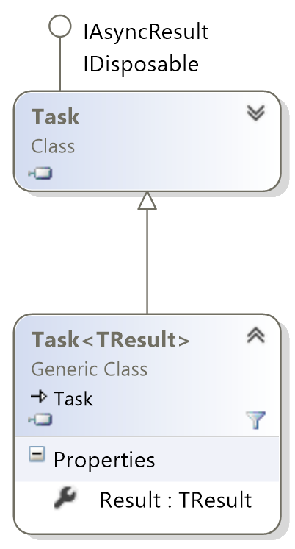
Getting a result from a Task
Task<T> derives from Task and supports returning a single value, called a future or promise, from the delegate worker
Derives from Task
Adds a Result property of type <T> to retrieve a single result value from the task
Notes:
We often want to return a result from our CPU-bound operations. That's the purpose of Task<T>.
> Derives from Task
> Adds a Result property of type T
> Allows a single value to be returned from the Task.

Slide 19
Getting a result from a Task
Task.Run has an overload that uses Func<TResult> as the worker delegate
Task<byte[]> t1 = Task.Run(new Func<byte[]>(ReverseWavFile)); ...
byte[] reversedWavData = t1.Result;
Get the return value using the Result property; this will block until the task completes and the result is available
byte[] ReverseWavFile() { ... }
Notes:
We populate the Result property by returning a value from our delegate handler.
> Task.Run (and Task<T> constructor) can take a Func<T> instead of an action.
> Task constructor can also take a Func<T,R> to pass an object parameter.
Final result from the delegate method is used to populate the Result property.
> Cannot set Result property yourself.
When you access Result (getter), it will return the final value.
If the Task is not finished, Result will block the caller and wait on the Task to complete which is not desirable when you are the UI thread.

Slide 20
Getting a result from a Task
Task.Run has an overload that uses Func<TResult> as the worker delegate
Task<byte[]> t1 = Task.Run(new Func<byte[]>(ReverseWavFile)); ...
byte[] reversedWavData = await t1;
Can use await to efficiently wait without blocking for the task to produce a value
byte[] ReverseWavFile() { ... }
Notes:
Again, we will use async/await to fix this.
Await will pull the Result property from the task automatically if it's a Task<T>.
> Will return back to the caller if result is not available yet
> and then continue execution once task is finished.

Slide 21
Be careful: Await != Thread
The awaitable expression must provide the asynchronous capability
async void button1_Click( ... ) { Action work = CPUWork; await RunWorkAsync(work); }
async Task RunWorkAsync(Action work)
{
work();
}
CPUWork will be executed synchronously!
Notes:
Keep in mind that await does not know anything about how the operation will be completed. It does not create a thread, or even require a thread be used. The awaitable operation might use a thread, or it might use some other technique.
Await doesn't really care about the details – it's really only interested in coordinating the work – ensuring that the statements which follow are not executed until the awaitable expression is completed.
How the awaitable expression performs the async operation doesn't matter at all.
Here's a quick example. This code will compile perfectly, and it applies async and await properly to the methods.
[Next]
The RunWorkAsync method returns an awaitable through the async keyword being applied - however it will execute the work synchronously and lock up our UI when we execute this code.
[Instructor Notes:]
See: http://blog.stephencleary.com/2012/02/async-and-await.html for a nice summary of this.

Slide 22
Be careful: Await != Thread
The awaitable expression must provide the asynchronous capability
async void button1_Click( ... ) { Action work = CPUWork; await RunWorkAsync(work); }
async Task RunWorkAsync(Action work)
{
await Task.Run(() => work());
}
Starting a task will move the work onto a thread
Better!
Notes:
Instead, we need to get our RunWorkAsync method to run the code as on another thread using a Task. If you're not familiar with tasks, that's ok. In short, Task.Run will execute the passed delegate on another thread and return you an awaitable operation in the form of a new Task.
This makes our routine truly asynchronous. Notice that we are applying the async and await keywords here, this is fairly common but is actually unnecessary in this case because we are not executing any code after the work – in this case we are simply returning from the method.
So a better way to structure this when you are ending on the async code is to do this:

Slide 23
Be careful: Await != Thread
The awaitable expression must provide the asynchronous capability
Can just return the Task directly if we don't need to process results
async void button1_Click( ... ) { Action work = CPUWork; await RunWorkAsync(work); }
Task RunWorkAsync(Action work)
{
return Task.Run(() => work());
}
Best
Notes:
We can remove the async and await off our RunWorkAsync method. We simply return the awaitable expression directly which allows the caller to use await to work with it.
The key takeaway here is that await is all about composing and managing the asynchronous operations so you can write more understandable code. It does not actually cause your code to be asynchronous – that's up to the awaitable expressions you are using await on.

Slide 24
Execution progress for await
At runtime, each await keyword starts the asynchronous operation and then returns to the caller because it cannot continue execution yet
async void OnClick(...) {
string url = ...;
indicator.IsRunning = true; await ReadFromUrlAsync(url);
indicator.IsRunning = false; }
async Task ReadFromUrlAsync(string url) {
WebClient wc = new WebClient();
byte[] result = await wc.DownloadDataTaskAsync(
new Uri(url));
var data = Encoding.GetString(result); LoadData(data); ...
✔
✔
Notes:
Remember from our earlier example that await causes our methods to pause forward execution until the asynchronous operation has completed.
Since we don't want to block the thread and wait on those results, we need to the thread doing something. That something is to return back to the caller of the method using async and await and continue executing code from there. This can be a little hard to visualize, so let's walk through an example.
[Next] Let's start in a Button Click method. This is called on the UI or main thread of our app.
It will begin executing statements to adjust the UI.
[Next] Then it calls a method: ReadFromUrlAsync
[Next] That method will create a new WebClient object.
[Next] Then it calls a method to download some data asynchronously.
This method returns a Task which we use the await keyword on. We cannot continue forward execution in this method, so it returns a Task back to the caller method – OnClick in this case.

Slide 25
Execution progress for await
… then when the awaitable expression has a result, the runtime will return to the method where it left off to continue execution
async void OnClick(...) {
string url = ...;
indicator.IsRunning = true; await ReadFromUrlAsync(url);
indicator.IsRunning = false; }
async Task ReadFromUrlAsync(string url) {
WebClient wc = new WebClient();
byte[] result = await wc.DownloadDataTaskAsync(
new Uri(url));
var data = Encoding.ASCII.GetString(result); LoadData(data); ...
✔
✔
✔
✔
✔
✔
UI thread processes other UI events while waiting for the data to be downloaded
✔
Notes:
Once we return, notice we've got an await on this call here as well – that again means we cannot continue forward execution on this method either, so the UI thread then returns back to the operating system that reported the click.
At this point, we are doing some I/O operations and neither method has actually finished all the code.
> The I/O is being done asynchronously
> Our UI (main) thread is doing more UI things – keeping our UI alive and responding to additional user activity.
[Next]
At some point, the I/O will complete, and when it does, the UI (main) thread will return back to the ReadFromUrlAsync method to finish the method. It will take the data result and get a string from it.
[Next] and load the data into the UI or process it in some fashion.
[Next] That finishes the execution of this method and the thread returns back to the operating system.
However, this also completed the Task we returned back to OnClick to represent this method finishing and because we used the await keyword on the task, that will cause the UI (main) thread to return back to our OnClick handler and pick up where it left off.
[Next] Resetting the indicator and finally again, returning back to the operating system.
Let's look at this workflow a bit more graphically.

Slide 26
Valid return values for async methods
Because awaited methods return before the entire method is complete, they must have a specific return type, one of three valid values:
Task<T> if it returns a value
async Task<double> CalculatePiAsync()
Notes:
So we can't just return anything from a method marked as async – the compiler requires we return one of three types.
First, as you just saw, we can return a Task<T>. This is what you should always return if you have a result coming back from the method.

Slide 27
Valid return values for async methods
Because awaited methods return before the entire method is complete, they must have a specific return type, one of three valid values:
Task<T> if it returns a value
Task for no return value (e.g. void)
async Task WriteToLogAsync(...)
Notes:
Next, you can return a simple Task if you have no results – in other words if you would have made the method a void return type were it not marked as async.
Because it's a task, this allows the caller to await on your method.

Slide 28
Valid return values for async methods
Because awaited methods return before the entire method is complete, they must have a specific return type, one of three valid values:
Task<T> if it returns a value
Task for no return value (e.g. void)
void for event handlers
async void OnClick(...)
Notes:
Finally, it is also possible to use a void return type. However, this is reserved primarily for event handlers – in other words where you are implementing a delegate method that requires void, or a virtual method that returns void where you cannot control the return value.
Be very careful with async void - it is allowed specifically for overrides, but it's quite dangerous.
> First, the caller cannot await your method – that means your method is always a "fire-and-forget" method with no ability to get a result or even know when it's finished.
> More importantly, since you cannot await the method, you also cannot catch exceptions that occur in the asynchronous code. That means you will not know whether the method failed or not.
Bottom line is do not use void-return types with async, always return Task, unless you have a very good reason not to.
[Instructor Notes:]
Side note if someone asks. Exceptions that occur in a Task are always considered "handled" and never result in an application termination on their own – even if user code never sees it. So the concern with not being able to catch exceptions isn't because the app will be terminated. It's really just that you don't know the final result of the async method.

Slide 29
Mapping await to threads
Sometimes it's beneficial to continue the work on the task, rather than switching back to the original thread
async Task ReadDataFromUrl(string url) {
WebClient wc = new WebClient(); byte[] result = await wc.DownloadDataTaskAsync(
new Uri(url));
var data = Encoding.GetString(result); LoadData(data); ...
Do we need to be back on thread #1 when we run this code?
Notes:
Let's look at processing results a little closer as well.
The async and await keywords were really designed with UI programs in mind – where we want to "interleave" our UI processing with other asynchronous things happening in the application.
However, in some cases we don't really care which thread we continue running the code on, library code in particular often doesn't need to return to the original thread in order to process an awaited call.
So, ask yourself the question – do we need to be back on the original thread when await returns?
Often the answer is "YES" and that's exactly the default before for await.

Slide 30
Staying on the task thread
Use ConfigureAwait(false) on the task to tell the API not to switch back to the original thread context if possible
WebClient wc = new WebClient();
Task<byte[]> task = wc.DownloadDataTaskAsync(new Uri(url)); byte[] result = await task.ConfigureAwait(false); var data = Encoding.GetString(result);
Notes:
If the answer is "NO", we can actually provide a directive to the awaited call to indicate that we want to continue running the remainder of the method on the worker thread, or I/O thread that actually performed the background work.
We do this by adding a call to ConfigureAwait onto the task and passing false.
The point: we do not want to capture the current thread context and return to it when the awaited call is complete, but instead we want to stay on the worker thread.
This is more efficient for a few reasons:
> We avoid a thread switch back to the UI thread; this is the big savings.
> We continue on the current thread's quantum, so we often end up executing the code quicker.
> The state machine doesn't need to capture the thread context.
You should not use ConfigureAwait when you have code after the await in the method that needs the thread context. For mobile/GUI apps, this includes any code that manipulates visual controls.
Note that you do not need to be on the UI thread to perform PropertyChanged updates for Xamarin.Form's binding engine. The binding itself will properly transition to the UI thread for you, however, by default, you do need to be on the UI thread to manipulate ObservableCollections.

Slide 31
Staying on the task thread
Use ConfigureAwait(false) on the task to tell the API not to switch back to the original thread context if possible
WebClient wc = new WebClient();
Task<byte[]> task = wc.DownloadDataTaskAsync(new Uri(url)); byte[] result = await task.ConfigureAwait(false); var data = Encoding.GetString(result);
Thread #1
This can be more efficient when data processing does not need to be on the original thread (e.g. UI) because we avoid the cost of switching threads
Worker Thread
Notes:
When we use this approach, our thread execution is actually quite different.
> We execute the first part of the method on the UI thread
> The remainder is all performed on the worker thread in parallel to the UI thread
So, by using ConfigureAwait, we enable a small amount of parallelism without interrupting the UI thread. Keep in mind that this does not affect our calling method – remember we return back to the caller on the main thread when it hits the await call. So this really is just changing the thread that the rest of this method executes on. For library calls which are unaware of the UI, this can be a nice efficiency optimization.
[Instructor Notes:]
Most people think you only need to use ConfigureAwait on the 1st awaited call, however it's recommended you use it for every await in that method after that point because it's possible that the task completed before it was awaited. In this case, the context is not captured and the method continues execution on the current thread (which in this above code case would be the UI thread).

Slide 32
Staying on the task thread
Beware: ConfigureAwait can return back to the original thread if the task completes immediately (e.g. no asynchrony occurred)
// Start on Thread #1 (UI thread)
await Task.FromResult(0).ConfigureAwait(false);
// Still on Thread #1! await Task.Delay(0).ConfigureAwait(false);
// Still on Thread #1!
await Task.Delay(1000).ConfigureAwait(false);
// Now on some other thread..
Notes:
There's one thing you should be aware of with ConfigureAwait. If the task you are awaiting completes immediately – without involving any other thread, then await will come back on the original caller thread regardless of how you have configured it.
Here on the slide you can see three examples which return tasks – however in several cases these don't involve a second thread of execution. In each case we are calling ConfigureAwait.
> We start on thread #1.
1. First we use Task.FromResult to create a completed task and await it.
> This returns on the calling Thread - #1 in this case.
2. Next we use Task.Delay but pass in zero.
> Again, since there is no delay, this returns immediately with the task in a completed state on Thread #1.
3. Finally, we call Task.Delay again, this time passing in a 1sec delay. This time, the task delays for 1 second and then returns completed – and we are on some other thread (not thread #1).

Slide 33
Manually switching back to the UI thread
You can get the best of both worlds by pushing the majority of the work onto the background/worker thread and switching to the UI thread to update the UI
Reading from URL
Process the data
I/O
UI thread
ReadFromUrlAsync
UI Activity
Fill in UI with calculated data
wc.DownloadDataTaskAsync
.ConfigureAwait(false)
Notes:
The downside with ConfigureAwait is that you are then stuck on the worker thread – what if you'd like to continue working on the background thread, but then at the very end transition back to the UI thread to update the UI? Or perhaps more likely, you'd like to perform periodic updates of the UI while doing some background work? In this case, await and ConfigureAwait won't really help you.
For example, here we'd like to process the data read on a non-UI thread .. We could kick off another Task, but that seems a bit much given that we already have a nice background thread we could use.
If we could do a last-minute switch to the UI thread at the end, we could optimize our work properly.

Slide 34

Switching to the UI thread
BeginInvokeOnMainThread(() => { resultLabel.Text = calculatedValue.ToString(); });
RunOnUIThread(() => { resultLabel.Text = calculatedValue.ToString(); });
Device.BeginInvokeOnMainThread(() => { resultLabel.Text = calculatedValue.ToString(); });
Notes:
It turns out we can do this. Each platform – iOS, Android and Windows have a unique, platform-specific API to force a context switch and run a delegate on the UI thread.
For example, in Android, we use the RunOnUIThread method, in Windows, Dispatcher.BeginInvoke. If you are using Xamarin.Forms, you can use the Device.BeginInvokeOnMainThread as shown here.
In this code example, we are in a loop on a background task – we need to perform periodic updates of the UI and so we use Device.BeginInvokeOnMainThread to change the status of a label in our loop.
But what if you are writing shared code which cannot rely on the platform?

Slide 35
Modifying collections
Changes to ObservableCollection<T> must be done on the UI thread
void OnProcessWebServiceUpdates(Person[] people)
{
Device.BeginInvokeOnMainThread(() => {
foreach (var person in people) {
Contacts.Add(person);
}
}); }
Must make sure to switch to the UI thread before altering the collection data
Notes:
Collections, like commands, aren't quite as simple.
Unlike normal property bindings, the INotifyCollectionChanged interface requires that you are on the UI thread in order to work properly.
This ensures thread safety when modifying the collection and pushing those changes to the UI as the collections and the UI are not thread safe and require synchronization.
The easiest way to provide that synchronization is to ensure we are always on the same thread.
We can do that by using Device.BeginInvokeOnMainThread as shown here, or if you want to be platform-agnostic, the SynchronizationContext approach you just saw.

Slide 36
Awaitify-ing existing APIs
TaskCompletionSource<T> can be used to make non-async code awaitable
public Task<bool> DisplayAsync(string title, string message, string accept, string cancel)
{
var tcs = new TaskCompletionSource<bool>();
Device.BeginInvokeOnMainThread(async () =>
{
tcs.TrySetResult(await Page.DisplayAlert(title, message, accept, cancel));
});
return tcs.Task;
}

Slide 37
Coordinating multiple tasks
Never forget that await coordinates activity – it can inadvertently reduce parallelism in your code
Task priceAA = ..., priceDelta = ..., priceUnited = ...;
List<Task> runningTasks = { priceAA, priceDelta, ... };
for (int i = 0; i < 3; i++) {
await runningTasks[i];
... // Process results
}
What's the problem with this code?
Notes:
One problem we've got with our current lab is that it's retrieving the URLs one at a time. You might have noticed that we haven't really improved the performance much yet.
The problem is that we are using await to process the results of the download – and await causes us to synchronize our thread against the downloader thread - which in this case isn't really what we want.
In this code fragment you can see the same issue.
[Next] Q: What will happen when await is called?

Slide 38
Coordinating multiple tasks
Better to start multiple related tasks to get data and then efficiently wait for all of them to be finished before processing the results
Task priceAA = ...;
Task priceDelta = ...;
Task priceUnited = ...;
// Wait for all prices to be available before updating UI
await Task.WhenAll(priceAA, priceDelta, priceUnited);
// All tasks are complete, display results to user
...
WhenAll returns a new Task, which completes when all the passed tasks are finished
Notes:
We often just work with a single task at a time, and async/await are really designed with that model in mind. However, there are cases where we might kick off multiple tasks and then want to process their results either together, or independently.
In the first case where we'd like to process them all together, we can use the Task.WhenAll method – you pass in a set of running tasks and it will return a new coordinating task which can be awaited. That await call will return when all the specified tasks are complete.

Slide 39
Efficient processing of multiple tasks
Sometimes returning results can be processed as soon as the task is complete – independent of the other tasks we are waiting on
PriceAA
PriceDelta
UI thread
Do we need both to be finished to process the first one?
GetFlights
Task.WhenAll()
Task.Run(…)
Task.Run(…)
Notes:
The flow looks a bit like this. We call WhenAll and when all our child tasks have a final result, our main thread continues forward execution and can look at each task. Essentially we will wait until the final task is complete before processing any of them.
However, this is not an efficient design if the tasks we are waiting on are independent. In this case, we don't need to wait for the last task, sometimes we'd like process them as they return.

Slide 40
Efficient processing of multiple tasks
Task.WhenAny will return control when the first task is done – use a loop to continue processing the results in the order they are finished
List<Task> runningTasks = ...; while (runningTasks.Any()) { // Wait for the first task to finish
Task completed = await Task.WhenAny(runningTasks); // Remove from our running list
runningTasks.Remove(completed); // Process the completed task
CheckIfLowestPrice(completed);
}
Make sure to use await: Task.WhenAny returns a Task<Task> so code will compile without await but won't run properly!
Notes:
That's the idea behind Task.WhenAny.
This is also passed a set of running tasks, and it also returns a single, coordination task. But the returning task will complete when the first running task is done, which means the other tasks are potentially still running.
A good way to process this sort of logic is in a loop.
> Create a list to hold the running tasks
> Create a loop which runs while we have running tasks
> When the task completes, remove it from the list.
> Process the results – can even kick off another task to do so.
> Loop back to grab the next one until we are finished.
[Next]
One very important detail here – make sure to use await in the loop. Task.WhenAny returns a Task<Task> which means if you assign it to a Task, it would compile just fine but not work the way you expect it to!

Slide 41
Task cancellation
CancellationTokenSource
Creates cancellation tokens and sends cancellation requests to all copies of that token
CancellationToken
Used by listeners to monitor current token state
var cts = new CancellationTokenSource();
var token = cts.Token;
Task.Run(async () => await someLongRunningAction(), token);
cts.Cancel();

Slide 42
Task cancellation
CancellationTokenSource
Creates cancellation tokens and sends cancellation requests to all copies of that token
CancellationToken
Used by listeners to monitor current token state
var cts = new CancellationTokenSource();
var token = cts.Token;
Task.Run(async () => await someLongRunningAction(), token);
cts.Cancel();
Careful: This task may still run!
Notes:
Task.Run(Action, CancellationToken) only checks if token has been cancelled at the start of the task

Slide 43
Ensuring task cancellation
Checking cancelled status is a manual process!
var cts = new CancellationTokenSource();
var token = cts.Token;
Task.Run(() => {
for (int i = 0; i < 3; i++) {
token.ThrowIfCancellationRequested();
// Do some more work
}
}, token);
cts.Cancel();
Notes:
Could also do if (token.IsCancellationRequested) return;

Slide 44
Exercise 1: Asynchronous programming
Scenario:
You will be given a console app that benchmarks performance of multiple sorting algorithms against each other. Currently the app uses async methods to compare algorithms, but the performance is less than ideal.
Improve the performance of the app by optimizing the asynchronous code.
Note: If you have not done so already, install the .Net Core 2.0 SDK from dot.net

Slide 45
Exercise 1: Asynchronous programming
Requirements:
Refactor Comparison.SortLists to better use async and await to compare algorithms faster
Use cancellation tokens to cancel unnecessary tasks
Fastest solution wins!

Slide 46
Awaitify-ing existing APIs
You can use TaskCompletionSource<T> to make non-async code awaitable
public Task<bool> DisplayAsync(string title, string message, string accept, string cancel)
{
var tcs = new TaskCompletionSource<bool>();
Device.BeginInvokeOnMainThread(async () =>
{
tcs.TrySetResult(await Page.DisplayAlert(title, message, accept, cancel));
});
return tcs.Task;
}

Slide 47
Ensuring task cancellation
Checking cancelled status is a manual process!
var cts = new CancellationTokenSource();
var token = cts.Token;
Task.Run(() => {
for (int i = 0; i < 3; i++) {
token.ThrowIfCancellationRequested();
// Do some more work
}
}, token);
cts.Cancel();
Notes:
Could also do if (token.IsCancellationRequested) return;

Slide 48
Additional resources
To learn more, refer to the following Xamarin University courses:
CSC 350, Using Async and Await
CSC 351, Writing Multithreaded Mobile Applications
CSC 352, Introduction to Thread Safety and Synchronization
CSC 353, More about Synchronization

Slide 49
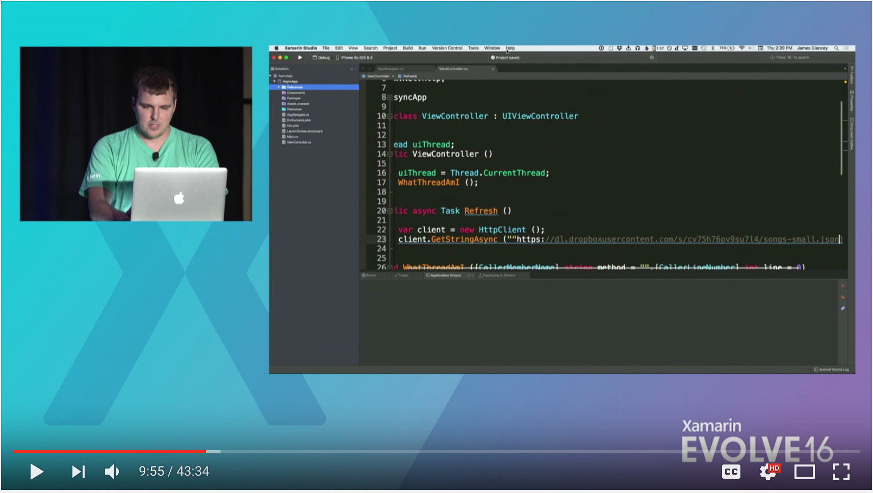

Reference: terrific video on async/await
“Async and Await: All the Things Your Mother Never Told You” by James Clancey www.youtube.com/watch?v=jgxJbshvCXQ&t=593s

Slide 50
Q & A

Slide 51
Architectural design

Slide 52






When choosing between Forms or Native, first ask questions
Forms sounds good
Do you want similar UI on all platforms?
native!
Will the app require a lot of custom renderers?
Forms!
Is code reuse more important than pixel-perfect layout?
Do you need to use a lot of native platform SDK features?
Choose native!
Xamarin.Forms
Xamarin.iOS Xamarin.Android

Slide 53
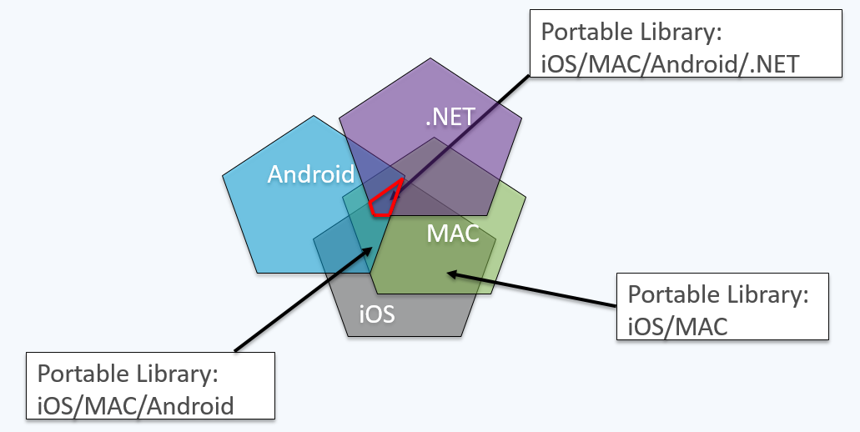
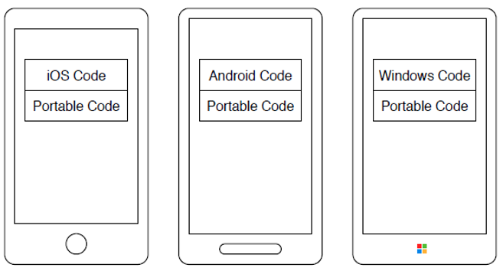
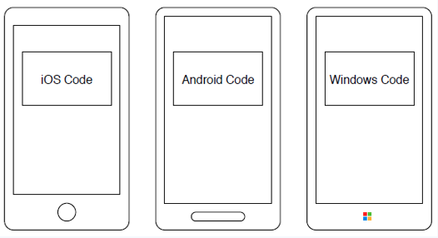
.NET Standard libraries vs. Shared Projects
.NET Standard
Shared
Reasons for and implications of choices
iOS project
iOS project
Shared project
Shared project
Android project
Portable project
Android project
Shared project
Windows project
Windows project
Shared project
Notes:
When using the portable class library approach, the code in the device has separately compiled the native code and the shared code in different projects
When using the shared project approach, the shared project is really a container—ALL the code is in the container and the application uses the different kinds of code based on COMPILER DIRECTIVES
So, the portable class library (PCL) approach is easier because it is simpler—not so many compiler directives and so MUCH LESS COMPLEXITY in the code.
Also PCLs can be constructed and reused as components and shared across multiple apps. For example an enterprise could have a PCL for sending email and this could be used for all the Android apps being created

Slide 54
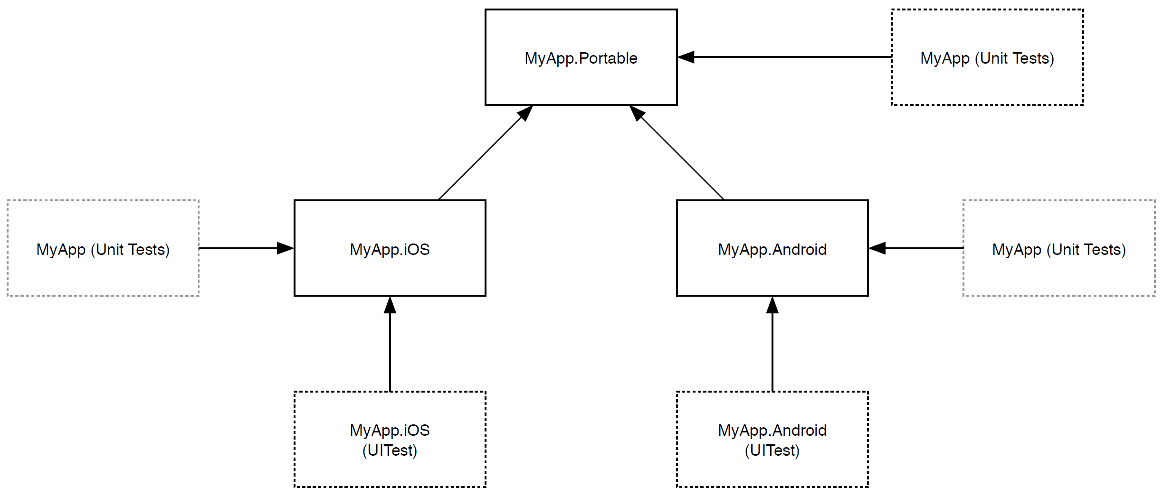
Architectural design: Complexity in a single app
In multi-platform development, every additional layer of code potentially requires a corresponding set of unit and UI tests

Slide 55
Architectural design: Complexity in multiple apps
Unit test
Unit test
Unit test
Common
iOS
Common PCLs
Common
Android
App 1
App 2
MyAPP
Portable Project
MyAPP
Portable Project
MyAPP
iOS
MyAPP
Android
MyAPP
iOS
MyAPP
Android
Notes:
As the number of apps increases, the complexity of related activities has to be taken into account and the consultant needs to be judge the capability of the client to be successful with this level of complexity

Slide 56
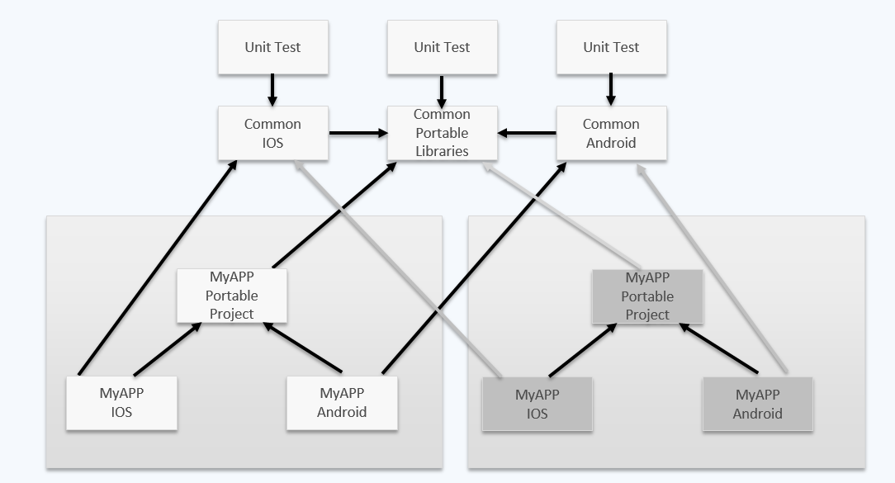
App 8
App 7
App 1
App 6
Complexity Increases
App 2
App 5
App 3
App 4

Slide 57
Unexpected advantage of complexity
Portable code can often be reused and repurposed for other apps and projects
For example:
UI-specific code in a library
Graphics-specific code in a library
Service-specific code in a library

Slide 58
Business requirements drive architecture

Slide 59
Scenario
A customer engages you to build a weather app for their field workers
The plan is to create a functional v1 using Xamarin.Native and then a polished v2 using Xamarin.Forms

Slide 60
Functional business requirements
Retrieve and present weather information for a specific city
Present a background image that matches the chosen city and the current weather conditions
Provide the ability to add favorite cities
Let user select a city from favorites (for weather lookup)
Enable the use of current location to get the weather for the nearest city (for weather lookup)

Slide 61
Technical requirements
Application must remain responsive to input at all times
Must handle errors gracefully and inform users when they occur
Minimize data usage (associated with image downloads)
Must use provided weather service API
Maximize code reuse across platforms
Must support Android and iOS
Any code that is not application-specific must be sufficiently decoupled to enable reuse
Mitigate the impact of any future potential changes in presentation technology, for example, moving from Xamarin.Native to Xamarin.Forms
The solution can only use approved third-party components and packages
Newtonsoft Json
Polly
SQLite

Slide 62
Discussion: How would you architect the solution?
Break into small groups of 3-4 people
Brainstorm how your group would architect a solution that meets the business requirements
Project structure
Third-party dependencies
etc.
Be prepared to present your solution!

Slide 63
Our solution: Project structure
How we divide up the code
Platform-specific, Forms, PCLs
Toolbox vs. app
Third-party dependencies
Json.net, sqlite-net-pcl
Our solution builds platform first, then Forms
To meet the narrative arc of our curriculum ☺

Slide 64
Q & A

Slide 65
Networking best practices

Slide 66
Web requests – challenges
Not backgrounding http calls
Insufficient network monitoring
Requests for large images
Lack of testing with poor connectivity
Lack of graceful degradation on dropped connections (e.g. displaying a pop-up every time a connection drops)
Multiple (unneeded) HttpClients created
Security
Notes:
ASP.NET Monsters: You're using HttpClient wrong and it is destabilizing your software
http://aspnetmonsters.com/2016/08/2016-08-27-httpclientwrong/

Slide 67
Efficient approaches to architecture
Use the platform-specific HttpClient implementations over the default (Mono) implementation
Make efficient use of HttpClients
Create a base class or service to handle frequent request types
Use async/await properly
Executing web requests within background threads
Backgrounding for iOS and Android
Effective de-serialization
Use cancellation tokens
Notes:
Make efficient use of HttpClients
One of the benefits of an HttpClient is that it can handle multiple requests so you don’t have to spin up or instantiate a new copy of an HttpClient every time you make a call. Unlike older approaches, such as a web client. We often see customers needlessly spinning up HttpClients. So this is a good thing to be aware of and on the lookout for.
Create a base class or service
A way to avoid having to create multiple instances of HttpClient is to create a base class or service, whose job is to handle things like creating the clients, setting the base address, receiving specific request URIs. Setting up a base object of things like request types such as delete, get, patch, put, post, so that you don’t have to re-create that functionality for every single service or repository.
This could be simple or complex, based on how simple of complex the customer’s setup is. This allows you to write it the one time and then re-use it for any subsequent services you may write.
Use Async/Await properly
We often see the incorrect usage of Async and Await or simply executing something in a background thread. Customers often attempt to execute these services within a background thread and get partially there but they may only kick off the Http request in the background thread but them and then when it comes back they may de-serialize the actual information back to the main thread or the UI thread.
There are appropriate techniques to the use of Async and Await.
De-serialization
There are a few libraries that you can use for de-serialization including System Json, which you can use for manual de-serialization. We tend to use Newtonsoft’s Json package for de-serialization because we’ve found that it works pretty well and most clients typically use it. These work for when we’re specifically targeting JSON. You rarely see customers using SOAP services or WSDL based but that can certainly occur.
Add cancellation tokens
CancellationTokens: https://msdn.microsoft.com/en-us/library/dd997289(v=vs.110).aspx

Slide 68
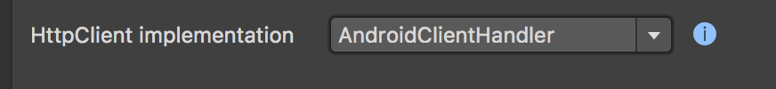
HttpClient
Use the platform-specific HttpClient implementations over the default (Mono) implementation
Better performance
TLS 1.2 Support

Slide 69
Monitoring and maintaining reachability
Affects apps in use outside urban areas
Inconsistent connectivity
Dropped connections or over weak signals
Connectivity plug-in
Alerts when there is a network change
Checking to see if there is a connection
Get Xamarin.Essentials here: https://github.com/xamarin/Essentials
Notes:
Reachability is a really big problem that we often run into when working with customers, especially customers who are creating consumer apps. Especially when the app users are people who might be dispersed widely, for example outside of urban areas. These people might have inconsistent connectivity—they could drop off of Wi-Fi, onto a carrier signal that’s pretty weak.
We often see that customer’s don’t seem to account for the possibility that their users could experience losses in service or intermittent connectivity. This leads to problems like a lack of exception handling when they’ve lost connection completely or had a blip in connection when they’ve called a web service and they’ve gotten nothing back.
Connectivity plug-in
We try to suggest that they monitor and maintain reachability, which can be done manually on all three platforms with varying approaches. We like to suggest a particularly good library called the Connectivity plug-in that James Montemagno created for Xamarin specifically, which you can use through the platform-specific projects or through PCLs.
The Connectivity plug-in provides two main things:
It will kick off an event to tell the user/underlying app about a status change (for example, you’ve lost connection, gained connection, your are connected) so that the app can then offer a message to indicate the change in status (“you’ve lost your connection, do you want to retry?”) or perhaps offer some kind of offline mode so that you can still use the application but it will stop trying to use the service and will instead store information locally to be synced later when connectivity is restored.
On the call to the service to make the request, the app can say Am I connected? If I am, then go ahead and make the call. If not, prompt the user or do something locally such as store something and then switch to some kind of offline mode and be able to then switch to check or wait for a status change of some sort.
Sample code: https://github.com/jamesmontemagno/Xamarin.Plugins/tree/master/Connectivity/TestApps

Slide 70
Exercise 2: Make http calls
Extract the starting solution for this exercise from Dev_Exercise2_Begin.zip
Build the app services: WeatherService and ImageService
Make these services available to both app targets
Call both of these services when the app launches

Slide 71
Exercise 2: Make http calls – Weather services
Requirements:
Must enable requesting weather by city name e.g. Seattle
Must retrieve a background image by city name and the current weather e.g. cloudy
Use a base class for your services to keep your code DRY (i.e. “don’t repeat yourself”)
APIs:
Base address for both services: https://xvtsfapktnxnh4rzvvie.azurewebsites.net/api/functions
WeatherByCity: Weather/WeatherByCity?city={city}&unit=imperial
BackgroundByCityAndWeather: Image/ImageBackgroundByCityAndWeather?city={city}&weather={weather}&height=1920

Slide 72
Exercise 2: Make http calls – Weather services
Starting point:
Create a Base Service to make the service implementation more DRY
Create a WeatherService class to handle calling the weather endpoint
Create an ImageService class to call the weather image endpoint
***BONUS*** Display alert when a response is returned ***BONUS***

Slide 73
Building layouts – Using designers vs. code
Designers | Code
Xamarin.iOS and Xamarin.Android support native designer tools: iOS Storyboards and Xibs Android XML Layouts | The UI for both platforms could also be laid out entirely in code
Pros: Quick to get started Design-time feedback for layout Lets UX designers participate in UX delivery | Pros: Simple to implement custom drawing code Simple to create responsive layouts Layouts can be more performant
Cons: Custom drawing code isn’t possible Constraint systems can be very touchy Too many constraints can hurt layout performance Inflating XML (Android) can hurt layout performance Merging layout files is error prone | Cons: Runtime-feedback for layouts

Slide 74
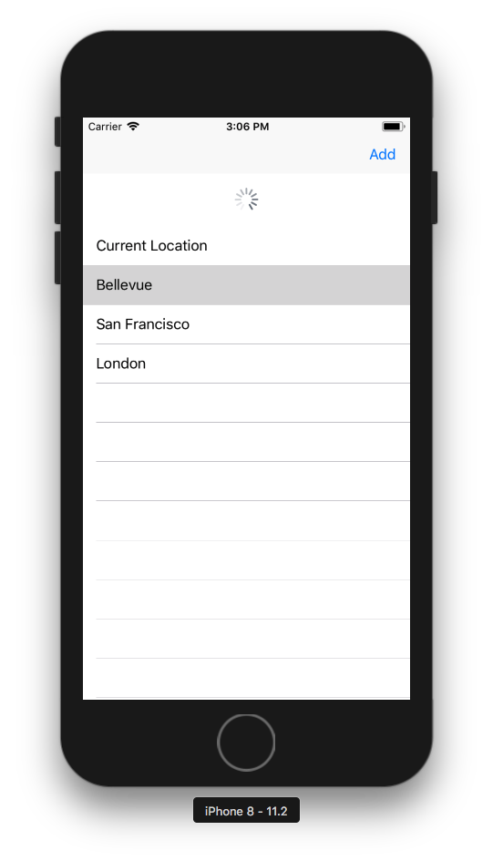
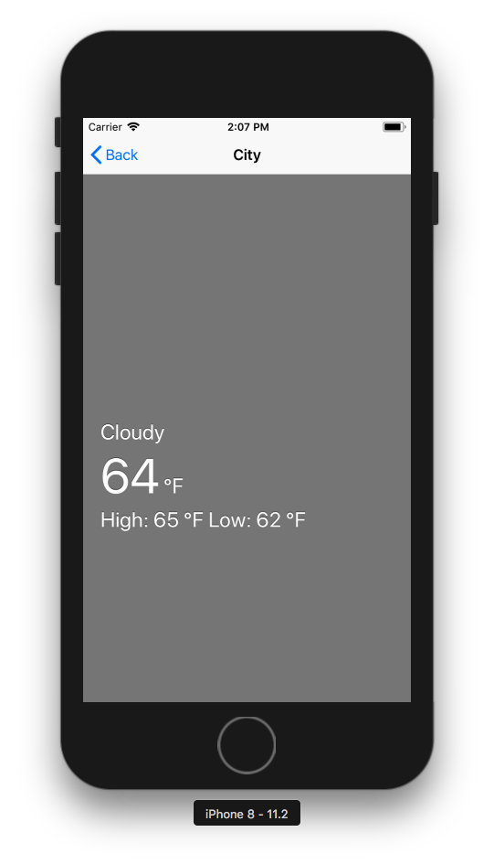
Exercise 2.5: Build a layout in code – no designers!
Open Dev_Exercise2_End
Add a UIViewController/Activity for the Detail view
Build the UI for both the list and detail views, as shown here
Note: Use static data for the purposes of this exercise

Slide 75
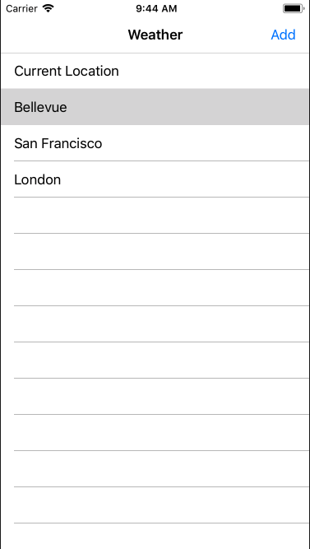
Exercise 2.5: Build a layout
Open Dev_Exercise2_End
Add a UIViewController/Activity for the Detail view
Build the UI for both the list and detail views, as shown here
Note: Use static data for the purposes of this exercise

Slide 76
Q & A

Slide 77
Architectural patterns

Slide 78
Benefits of using a pattern
Separation of concerns
Easier to maintain
Encourages reusable and extensible code
Better developer (and designer) workflow
Notes:
MVC: Model-View-Controller
MVVM: Model-View-ViewModel

Slide 79
Model-View-Controller (MVC) pattern
The recommended/default pattern for iOS apps and many web technologies.
Provides for a separation between:
View: the actual definition of a UI/Screen
Controller: the engine behind it that handles interaction
Model: the data that populates it
***The model is completely optional so the core usage of this pattern is often in the relationship between the View and Controller
Controller
Update
Update
Notify
User action
Model
View

Slide 80
MVC (continued)
The Model-View-Controller (MVC) pattern is very common and is the recommended/default pattern for iOS apps as well as many web technologies.
MVC provides for a separation between the actual definition of a UI/Screen (View), the engine behind it that handles interaction (Controller/ViewController), and the data that populates it (Model).
The model is actually a completely optional piece and, therefore, the core usage of this pattern is often in the relationship between the View and Controller.

Slide 81
Model-View-ViewModel (MVVM) pattern
The Model-View-ViewModel (MVVM) was introduced at the beginning of WPF to address separation of concerns and improve testability
MVVM is composed of three parts:
Model: corresponds to the data you’ll want to display and manipulate on screen
View: the presentation component and the UI
ViewModel: displays Model data in the View using data binding and responds to user input
Data binding
Data binding
User input
Model
⚡︎
ViewModel
⚡︎
View
📱

Slide 82
MVVM (continued)
MVVM was originally built for Windows-based apps built with XAML and data binding (methods, properties, and events).
Although other platforms come with their own development models and recommended approaches, it is possible to bring the MVVM pattern to those platforms with additional supporting infrastructure (or third-party framework).
Key to enabling this pattern is support for keeping the View and the ViewModel in sync and facilitating the use of commands.
Notes:
In Xamarin.Forms and Windows, it is possible to use data binding to connect the view to the view model with typically no additional code. An equivalent mechanism must be provided for Android and iOS. Most commonly, to enable parts of the View to refresh in response to a change to a given property and where a given ViewModel property value can be set to reflect changes to a UI element value or a command can be executed when specific user input is detected e.g. tapping on a button.

Slide 83
MVC and MVVM differences
MVC | MVVM
Commonly associated with and has origins as a server-side programming pattern; spans many platforms/languages | Developed as a client-side pattern with most support and usage by C# developers
The Controller is the object that changes and manages both the Model and the View | The ViewModel represents the data (and view state) on the client; the Model represents the data on the server
Uses a Controller to populate a Model and then provides it with a View to display it | Leverages the Observer pattern to keep the View in sync with the Model data that backs it

Slide 84
Choosing between MVC and MVVM
Both are great patterns with supporting frameworks
Matter of preference and/or familiarity with a given pattern
MVVM is often chosen for:
XAML-based applications (Windows/Xamarin.Forms) with data binding support
Driving greater code reuse and testability across multiple platforms, especially those written using C#
Developers familiar with this pattern, a supporting framework or native Windows apps

Slide 85
Code share with MVVM
Model - WeatherRequest
Position
City
ViewModel:
LoadWeatherCommand
Collection<WeatherRequest>
Activity
UIViewController
RecyclerView.Adapter:
ItemCount
OnBindViewHolder
UITableViewSource:
NumberOfRows
NumberOfSections
GetCell
RecyclerView
UITableView

Slide 86
Demo: Custom binding engine

Slide 87
Exercise 3: Migrate to MVVM
Scenario:
We’ve provided the initial application views but they have not been connected to any data source or viewmodel. The detail viewmodel needs to be completed and connected to the detail view.

Slide 88
Exercise 3: Migrate to MVVM
Complete the WeatherDetailViewModel by using the WeatherService, LocationService, and ImageService
Connect the WeatherDetailViewModel to the WeatherDetailView
Ensure that the View reacts to changes in the ViewModel
Note: The Dev_Exercise3_Begin.zip file provides a location service. The use of this location service on Android requires Google Play Services.

Slide 89
Q & A

Slide 90
Additional resources
To learn more, refer to the following Xamarin University courses:
XAM250, Patterns for Cross Platform Mobile Development
XAM301, Mobile Application Architecture

Slide 91
Local storage

Slide 92
Local storage - Challenges
Database schema updates can be complex
Additive changes are always best
Offline synchronization IS complex
Managing across devices for a single user
For more information, see the notes section for this slide.
Notes:
It is worth mentioning to the customer that it can be very painful to change your database schema later on so it’s important to plan well at the outset.
For example, adding a column to a table or deleting a column from a table. Obviously, adding information is much easier than removing information but they will need to have a version of that database previously stored and then whenever they get an updated version of the application they will need to be able to compare the previous version to the new one and then will need to run through a process to get the database schema updated, which can be very complex.
SQLite supports the ALTER TABLE command to support limited schema changes using direct SQL statements e.g. renaming tables, adding new columns.
For more substantial changes (ensuring the operation is atomic):
Create a transaction
Rename the old table
Create a new table using the original name (the way you want it)
Copy the data adding default values for non-null columns
Drop the old table
Commit the transaction
Have a plan in place for how to handle offline synchronization before launch.
Both of these are best handled early in the architecture.

Slide 93
Local storage - Benefits
Local storage can help you avoid redundancies, specifically related to web requests
Store things locally to avoid repeated network calls
Save on battery life
Improve performance
Notes:
The topics of web requests and local storage are related because local storage can help you avoid redundancies specifically in web requests by enabling you to store things locally so that you don’t need to grab more data later on by calling the network. This can help save on battery life and can also improve performance.

Slide 94
Local storage - Options
SQLite: relational database
Couchbase Lite: document database
Akavache
Realm
MonkeyCache
Native platform settings management
Manually writing to files (.txt, .xml, etc.)
Notes:
The purpose of this section is to describe the various local storage options and best practices for using them.
SQLite: the most prevalent option is kind of a relational database but really more of a flat file. Often when people use SQLite, we see threading issues because it’s hard to be able to maintain asynchronous activities on something that you basically get a giant lock on whenever it’s the one file and it’s hard to write to from multiple sources. Transactional issues are also a factor.
Akavache: Akavache, written by Paul Betts, is a key-value storage library that handles a lot of the complex transactional and threading issues that come with using SQLite. He created this package because transactions, asynchronous activity, and multi-threading on SQLite can be pretty tricky and can involve quite a bit of time. Users don’t need to do a ton of complex querying work in order to be able to store locally. What they really need is a fast way to be able to have this key value pair, which is exactly what Akavache is, to store things like user settings or, perhaps, a list of information, or more complex objects, all of which Akavache can do pretty well. But when they pull those things out, or the user pulls those things out in the application, they don’t necessarily need these extremely complex queries or joins or any of these things on tables. They already know what they’re looking for and they’re often stored very simply just using IDs or composite IDs of some sort for which they’ve created some scheme.
Other strategies you can use include platform-specific settings you can use to store things like user settings, simple data types and so on
Native Platform Settings Management: this package targets the actual platform settings.
https://github.com/jamesmontemagno/Xamarin.Plugins/tree/master/Settings - uses-the-native-settings-management
Manually writing to files (.txt, .xml, etc.)
Etc. (there are other local database options)
Security
All of these options have varying degrees of security, which means that it’s important for the mobile architect to probe a bit to determine more about the use case because if they’re storing user information that should be kept pretty private they might want to consider using encryption on the database.

Slide 95
Local storage - Offline sync solutions
SQLite: AzureMobileSync
Couchbase Lite
Realm
Rolling your own [custom] solution
(proceed with caution)
Notes:
It’s often important to keep in mind the idea of offline sync solutions, which can be pretty important in some scenarios, for example, a field service app (for oil, gas, forestry) that might be in and out of good signal strength as their doing their job. If they’re out in the middle of nowhere, they need a good way to keep using the application effectively but when they’re back into an area where they can send and receive data, they need all of the operations that they made within the application (save, delete, update) need to have been stored locally and then sync to the server or service when their connectivity is restored.
Effective offline sync solutions involve a combination of a few things.
Making those requests when they regain access to the server
Connectivity and reachability testing plays a large role
Syncing involves a component or a package of some sort that you can use in conjunction with Couchbase or SQLite to indicate that we have changes (deletions, updates, inserts) that we need to sync to the server.
The solution you choose will likely be determined by the customer’s setup. We’re rarely dealing with a completely new setup so we have to be flexible.
The “Rolling your own solution” option can be extremely complex depending on the customer’s setup.
It’s worth trying to go an easier route if that’s an option.

Slide 96
SQLite: options
The SQLite C/C++ engine is exposed to .NET through a C# wrapper
There are many C# API options available for use with Xamarin, which vary in difficulty and features. Most common:
SQLite (mono) - ADO.NET (included with Xamarin)
sqlitepcl – Microsoft thin wrapper over the C++ API
Entity Framework – Microsoft ORM framework
SQLite.Net – Open source ORM framework
Object-relational mapper (ORM) frameworks enable you to use such features as LINQ to retrieve and work against objects rather than using direct SQL database queries and simplifies how you define database schemas using model objects
We recommend using SQLite-Net PCL (sqlite-net-pcl) by Frank Krueger
Notes:
SQLite-Net has a dependency on SQLitePCL.raw_basic
Recommend SQLite-Net:
Cross-platform
Light-weight – fast thin wrapper
Easy and convenient ORM database layer
Works with your data model
Kept up-to-date
NOTE: We recommend adopting the repository pattern which can achieve the desired decoupling through interfaces.
Alternatively, consider using a base class you can derive from to better decouple model classes from for SQLite e.g. attributes etc. A factory can create the entity objects with SQLite specific attributes and return the base class so the app need not know it’s using SQLite specific objects.

Slide 97
SQLite: encryption options
Use SQLCipher:
Most popular
Encrypts the entire database
Supports iOS, Android, UWP
Has a high license fee
Use standard SQLite with custom encryption
Consider whether SQLite is required at all
Use Akavache when you only want key value storage
Use a hybrid approach
Akavache with secure storage option for sensitive data
SQLite for non-sensitive data

Slide 98
SQLite: faster when you…
Use transactions and bulk operations
Manage concurrency and access SQLite on a single thread
Remember ConfigureAwait(false) to stay in the background
For more information, see the notes section for this slide.
Notes:
Transactions
Unless you are already in a transaction, each SQL statement gets a new transaction started for it. This is expensive (very expensive) as it requires the reopening, writing to and closing of the journal file for each individual statement.
Bulk Operations
It’s possible to perform multiple updates in a single unit of work to further optimize performance. In SQLite-Net use InsertAll/UpdateAll and pass in a set of pre-prepared objects.
Concurrency
SQLite obtains a lock on the database file when a transaction is open and so it is better to manage the database from a single thread where possible and manage concurrency across multiple threads such as through a queue. The BlockingQueue would be a good choice as it provides better thread safety.
OTHER COMMON AREAS OF ENHANCEMENT:
Prepare commands ahead of time and reuse them (if you need to use direct SQL statements)
Consider coalescing operations into a smaller subset
Optimize PRAGMA settings *be aware of the trade-offs, benefits and limitations for a given scenario
Pre-prepared Commands/Statements
This is the recommended way to send queries to SQLite where the query statement is used many times. Defining them up-front (with placeholders where appropriate) means that they need only get parsed once rather than each time. It also guards against SQL Injection attacks. Ensure that these are cleared out before closing the database however.
Further Considerations
Most impactful gains will likely come from the use of transactions, bulk operations and use via a single thread
There is a balance to be struck regarding the number of operations performed within the same transaction. Executing a larger number of operations results in faster performance, however if one or more of the operations fail, then all operations in that transaction are rolled back and result in overall slower performance
Consider the use of read-only databases or temporary tables if performance is more important than data integrity. This will turn off journaling which, while providing the ability to roll back, adds overhead in terms of additional disk access
Consider compacting the database from time-to-time using the SQLite VACUUM command. This will avoid performance issues resulting in fragmentation of the database over time db.Execute("VACUUM")
Explore the use of PRAGMA settings; journal_mode, synchronous – but beware of the trade-offs and consider in the context of the requirements e.g. data integrity vs. performance
Prefer using the async methods (which are made easy with the ORM APIs)
Coalescing operations is difficult and can be error prone, but can help minimize the number of operations; law of diminishing returns applies
FYI: The ‘#pragma’ directive is most commonly known as the method specified by the C standard for providing additional information to the compiler, beyond what is conveyed in the language itself. In the context of SQLite, the PRAGMA statement is an SQL extension specific to SQLite and used to modify the operation of the SQLite library or to query the SQLite library for internal (non-table) data. See: https://sqlite.org/pragma.html
e.g. on initialize connection:
connection.Execute("PRAGMA journal_mode = WAL");

Slide 99
Using SQLite-Net (high-level steps)
Add the SQLite-Net PCL to the portable data layer project
Repeat that step for all other projects that reference that project (including the iOS/Android platform targets)
Create a helper class for resolving the native local file path (for storing the database)
Create the supporting model classes (one per table)
Create the repository classes initializing a new SQLiteConnection in the constructor (be sure to store this for later access)
Create the database (in the appropriate local file path)
Create the tables for the appropriate model class
Add code to support the relevant CRUD operations
Ensure that you choose the same package by Frank A. Krueger (sqlite-net-pcl)

Slide 100
Getting the local file path for the database
Path.Combine(personalFolder, “..”, “Library”, “subdirectory”);
i.e.
<AppHome>/Library/[subdirectory]
Environment.SpecialFolder.Personal
i.e.
<AppHome>/files
Notes:
The SQL database must be stored in a writable folder path which is platform-specific

Slide 101
Connecting to the database
SQLiteAsyncConnection has two constructors and a number of optional parameters
public SQLiteAsyncConnection(
string databasePath,
SQLiteOpenFlags openFlags,
bool storeDateTimeAsTicks = true
)
Notes:
Prefer true for ‘storeDateTimeAsTicks’ for performance reasons.
Use the ‘openFlags’ to control whether this uses read, write or sharing configuration.
It’s better to reuse the same connection for a set of operations rather than opening a new one each time – similar to the HttpClient. Be sure to call Dispose or Close when finished. The trade-off here is performance for memory and there is a balance to be struck.

Slide 102
Create a table
SQLite allows you to create a new table or update an existing table using your model classes. You can decorate the model class with attributes for more control over the schema.
SQLiteAsyncConnection connection;
…
await connection.CreateTableAsync<MyModel>();

Slide 103
Performing operations
You can perform CRUD operations on tables in a strongly typed manner using the model objects
SQLiteAsyncConnection connection;
…
public Task<List<MyModel>> GetMyModelsAsync()
{
return connection.Table<MyModel>().ToListAsync();
}

Slide 104
Using transactions and bulk operations
Executing a block of statements in a transaction is simplified by the RunInTransactionAsync method
SQLiteAsyncConnection connection;
…
public async Task<int> UpdateMyModelsAsync(List<MyModel> myModels)
{
int itemCount = 0;
await connection.RunInTransactionAsync(conn => {
itemCount += conn.UpdateAll(myModels);
});
return itemCount;
}
Notes:
Prefer bulk operations where possible e.g. UpdateAll and InsertAll. Consider coalescing queries to retrieve/delete all items from the same table rather than across multiple separate queries.
Create, commit and rollback transaction commands are available in SQLite-Net.

Slide 105
Demo: Comparing transactions
Notes:
Run tests (in simulator) and then show test code
* First test uses foreach loops with await to insert/update/delete each item
* Many times faster when putting that foreach in a transaction
* Even more gains by using the built in bulk operations for insert/update

Slide 106
Executing direct SQL statements
For scenarios where you need to execute direct SQL statements (for more complex queries), this is possible using ExecuteAsync, ExecuteScalarAsync, QueryAsync, GetAsync, and Find Async.
Note: You can use placeholders in these queries
SQLiteAsyncConnection connection;
…
int count = async connection.ExecuteScalarAsync<int>(“SELECT MAX(myValue) FROM [myModels] WHERE myOtherValue > ?”);
Notes:
You can also choose to execute direct SQL statements and queries with parameters. This is necessary for cross-table queries for example.
Methods:
ExecuteAsync
ExecuteScalarAsync
QueryAsync
GetAsync
FindAsync

Slide 107
Using commands
You can prepare and reuse commands. The SQLiteCommand has the same methods for executing direct SQL statements.
SQLiteAsyncConnection connection;
…
SQLiteCommand cmd = connection.CreateCommand(
"UPDATE MyModel SET myValue = @myValue, mySecondValue = @mySecondValue");
…
cmd.Bind("@myValue", "First");
cmd.Bind("@mySecondValue", "Second");

Slide 108
Challenges with accessing data directly
Duplicated and tightly coupled code
Programming errors more likely
Weak typing of business objects
For example, if the database you’re querying doesn’t use adequate specificity for its object types
Inability to test the business logic in isolation
Hard to centralize data-related actions such as caching
Notes:
Even when data access code is encapsulated within shared utility classes, the consuming business logic must still take a dependency on a single implementation of that utility and in many cases their underlying dependencies and types.
Note about concept of “weak typing”
SQLite uses dynamic typing and does not enforce type constraints in the same way as a traditional database.
It is possible to put any data of any type into any column interchangeably (but probably not on purpose). It does try to convert the supplied value into the preferred type, but this limitation is something to be mindful of and certainly a consideration when architecting the storage.
In addition, accessing the data directly greatly increases the chance of this happening versus having the data access managed in a centralized manner.

Slide 109
Q & A

Slide 110
Additional resources
To learn more, refer to the following Xamarin University course:
XAM160, SQLite and Mobile Data

Slide 111
Storage architecture

Slide 112
The repository pattern
An abstraction that decouples storage intent from the underlying storage mechanism
The business logic interacts through an interface, enabling flexibility of storage mechanism
Centralizes implementation of storage related code
The pattern enables easier unit testing of business logic

Slide 113
How the repository patterns works
Externally, the repository exposes storage operations on strongly typed business model objects
Internally it uses the underlying storage APIs implement storage operations, such as writing to a database
MockSampleRepository
Local JSON file
ISampleRepository
SampleRepository
SQL database
Business logic
Repository
Data store
CRUD operations
(business entities)
CRUD operations
(data store types)
Strong types
Weak types
Data mapping

Slide 114
Base repository - Interface
A base repository defines the common CRUD operations that all storage mechanisms perform
public interface IBaseRepository<T>
{
Task<List<T>> GetItemsAsync();
Task<T> GetItemAsync(string id);
Task<T> InsertAsync(T item);
Task<T> UpdateAsync(T item);
Task<bool> RemoveAsync(T item);
Task DropTableAsync();
}
Notes:
A base repository approach works well for an ORM driven SQLite data store.

Slide 115
Base repository - Implementation
The base implementation provides the common set of supporting operations for working against a given data store
public abstract class BaseSQLiteRepository<T> : IBaseRepository<T>
{
protected SQLiteAsyncConnection connection;
…
public virtual async Task<IEnumerable<T>> GetItemsAsync()
{
await InitializeAsync().ConfigureAwait(false);
return await connection.Table<T>().ToListAsync().ConfigureAwait(false);
}
…
}
Notes:
In this simplified example, the model classes defined in the business logic can be used directly without any further data mapping. However, if you need to decorate objects with attributes specific to the data store e.g. the SQLite PrimaryKey or AutoIncrement, then these entities can be decoupled from the business logic models themselves and mapped by the repository.
The connection can be initialized within the InitializeAsync method either directly or resolved via the StoreManager if this is used. For example, if a StoreManager is used, then the InitializeAsync method would be called here and a member reference to the StoreManager retained in each repository.

Slide 116
Repository - Interface
The interface describes the operations that are supported for a given repository
This can simply inherit those provided in the base as well as extending them with additional operations
public interface IMyModelRepository : IBaseRepository<MyModel>
{
Task<MyModel> GetByMyOtherModelProperty(string myOtherModelProperty);
}

Slide 117
Repository - Implementation
Each repository derives from the concrete base repository and implements the interface that represents that specific repository
public class MyRepository : BaseSQLiteRepository<MyModel>, IMyModelRepository
{
public Task<MyModel> GetByMyOtherModelProperty(string myOtherModelProperty)
{
await InitializeAsync().ConfigureAwait(false);
return await connection.Table<MyModel>()
.Where(x => x.Property == myOtherModelProperty)
.ToListAsync().ConfigureAwait(false);
}
}

Slide 118
Repository Manager - Interface
Access to the many repositories that may comprise a given solution can be simplified through a central Repository Manager class. This approach will often centralize data store initialization logic as well.
public interface IRepositoryManager
{
Task InitializeAsync();
IMyModelRepository MyModelRepository { get; }
…
}
Notes:
Handling the references to repositories in this way reduces the number of individual references that must be passed into the business logic via the service locator or dependency injection.

Slide 119
Repository Manager - Implementation
The IRepositoryManager implementation encapsulates the initialization of the SQLite database and creation of the individual repositories
public class SQLiteRepositoryManager : IRepositoryManager
{
internal static SQLiteAsyncConnection Connection { get; private set; }
private IMyRepository myRepository;
public IMyRepository MyRepository => myRepository ?? (myRepository = new MyRepository());
public async Task InitializeAsync()
{
…
Connection = new SQLiteAsyncConnection(“<path to database>”);
…
}
…
}

Slide 120
Using the repositories
The repositories can be made available to the business logic through patterns such as Service Locator or Dependency Injection
public class MyConsumingBusinessLogic
{
private IRepositoryManager repositoryManager;
…
public async Task LoadDataAsync()
{
var items = await repositoryManager.MyRepository.GetItemsAsync();
…
}
…
}

Slide 121
Exercise 4: Add local storage – SQLite database
Scenario:
The app currently uses an in-memory repository implementation. Favorites should be persisted between sessions and images should be cached, so we will need a more permanent storage mechanism.

Slide 122
Exercise 4: Add local storage
Implement a SQLite repository mechanism.
Use the ServiceContainer to register either the In-Memory or SQLite Repository implementation.
Ensure data is persisted between app runs.
Note: The toolbox contains a FileSystem class, which provides the directory where you will want to store your database file.

Slide 123
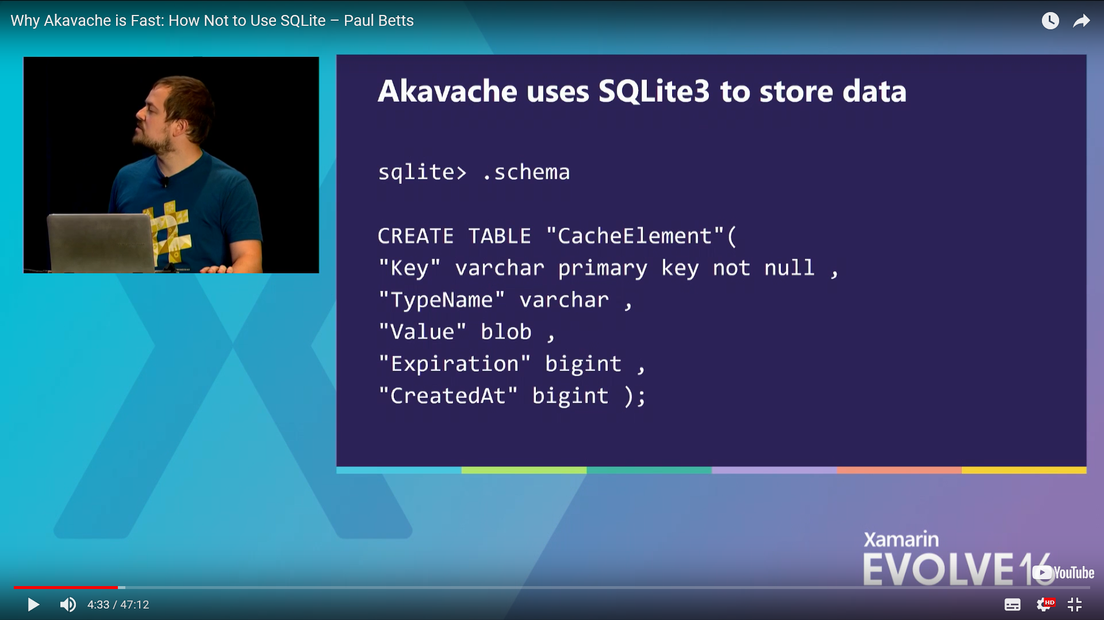
Reference: terrific video on how not to use SQLite
“Why Akavache is Fast: How Not to Use SQLite” by Paul Betts www.youtube.com/watch?v=j7WnQhwBwqA

Slide 124
Q & A

Slide 125
Custom views

Slide 126
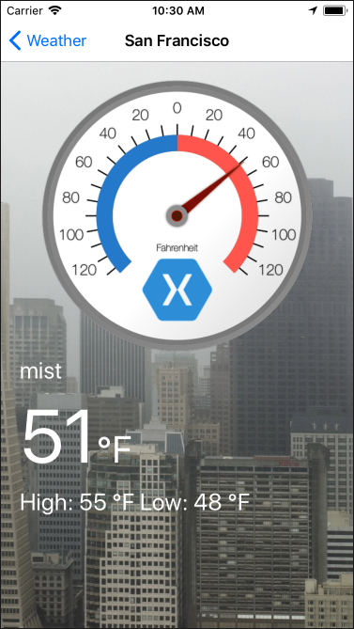
Discussion: Implementing a custom view
We’re going to add a custom thermometer view to our Weather app.
How would you suggest we implement it?

Slide 127
Thermometer view
We can add a custom thermometer view to our Weather app in several ways, for example:
View composition
Vector graphics

Slide 128
Consider reusability
Although it is advantageous to leverage existing controls, there are cases where it is necessary to create a custom control in order to achieve the user experience that you require. That is, when it is not possible to achieve the desired result via:
Configuration of available control properties
Combining existing controls into a composite
Additional code-behind
Styling and/or theming
It can also be better to create a custom control when achieving the same result through configuration is actually more complex, time-consuming, or adds higher maintenance overhead.
Notes:
Different platforms provide varying support for ‘advanced configuration’ which might make it possible to avoid customization. For example, enabling the complete or partial appearance of existing controls to be controlled through templating, styling/theming or through attached logic.

Slide 129
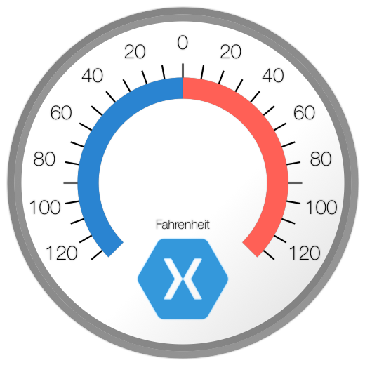

Exercise 5: Implement and add a custom view
Implement the custom thermometer view for iOS and Android using the provided image assets
Add these to the detail view showing the current temperature
Animate the needle from 0 to the current temperature after the data has loaded

Slide 130
Exercise 5: Implement and add a custom view
Requirements:
Ability to show different scales based on whether imperial or metric measurements are specified
The needle must update via animation when the temperature value changes

Slide 131
Linking

Slide 132
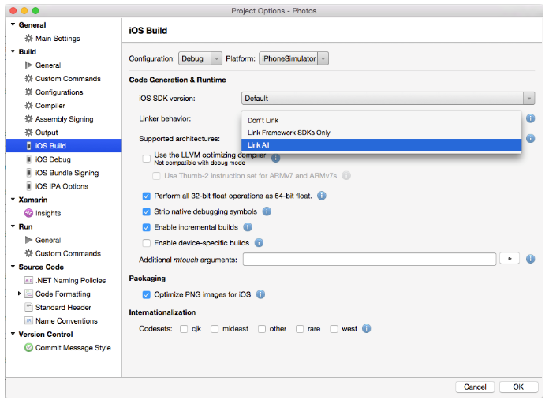
Reduce the size of the application by using the linker
To help reduce the size of applications the Xamarin platform includes a linker as part of the build tools
Linker options in Xamarin Studio for a Xamarin.iOS project
Notes:
About the compilation process for the different platforms:
iOS applications are ahead-of-time (AOT) compiled to ARM assembly language. The .NET framework is included, with unused classes being stripped out only if the appropriate linker option is enabled.
Android applications are compiled to intermediate language (IL) and packaged with MonoVM and just-in-time (JIT) compilation. Unused framework classes are stripped out only if the appropriate linker option is enabled.
Windows Phone applications are compiled to IL and executed by the built-in runtime.
In addition, if an application makes extensive use of generics then the final executable size will further increase since it will contain natively compiled versions of the generic possibilities.
The Xamarin platform includes a linker as part of the build tools to help reduce the size of applications.
The linker is disabled by default , and must be enabled in the project options for the application. At build time, it will perform static analysis of the application to determine which types, and members, are actually used by the application. It will then remove any unused types and methods from the application.
The linker provides three different settings to control its behavior:
Don’t Link – No unused types and methods will be removed by the linker. For performance reasons, this is the default setting for debug builds.
Link Framework SDKs/SDK Assemblies Only – This setting will only reduce the size of those assemblies that are shipped by Xamarin. User code will be unaffected.
Link All Assemblies – This is a more aggressive optimization that will target the SDK assemblies and user code. For bindings this will remove unused backing fields and make each instance (or bound objects) lighter, consuming less memory.
Linker.xml

Slide 133
Additional size reduction techniques
Ensure that a release build is produced
Reduce the number of architectures that the application is built for, in order to avoid a FAT binary being produced
Ensure that the LLVM compiler is being used, in order to generate a more optimized executable
Limit an overabundant usage of packages and/or components
Shared projects can be smaller than PCLs
Notes:
There are a wide variety of CPU architectures that power mobile devices. Therefore, Xamarin.iOS and Xamarin.Android produce fat binaries that contain a compiled version of the application for each CPU architecture. This ensures that a mobile application can run on a device regardless of the CPU architecture.

Slide 134
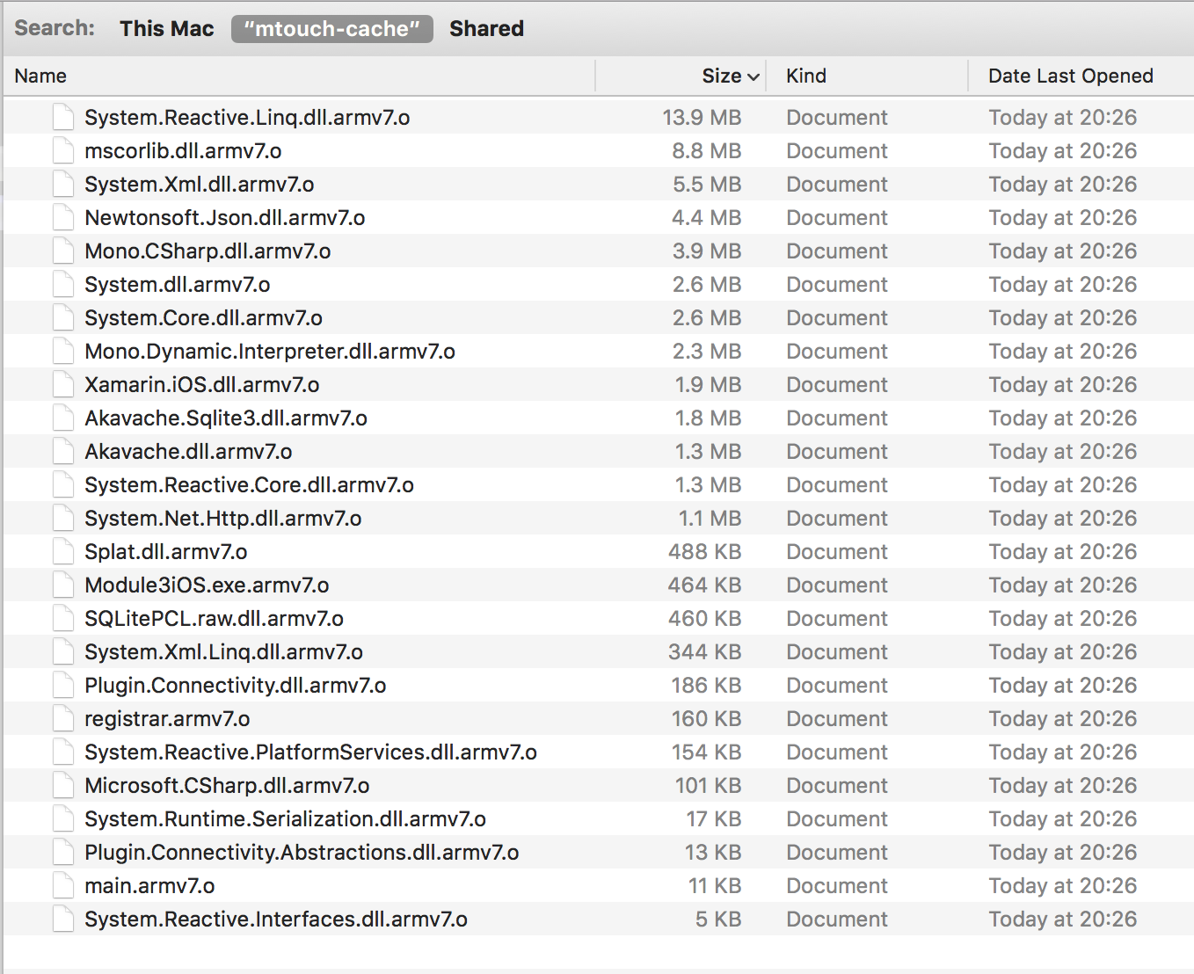
Bad app

Slide 135
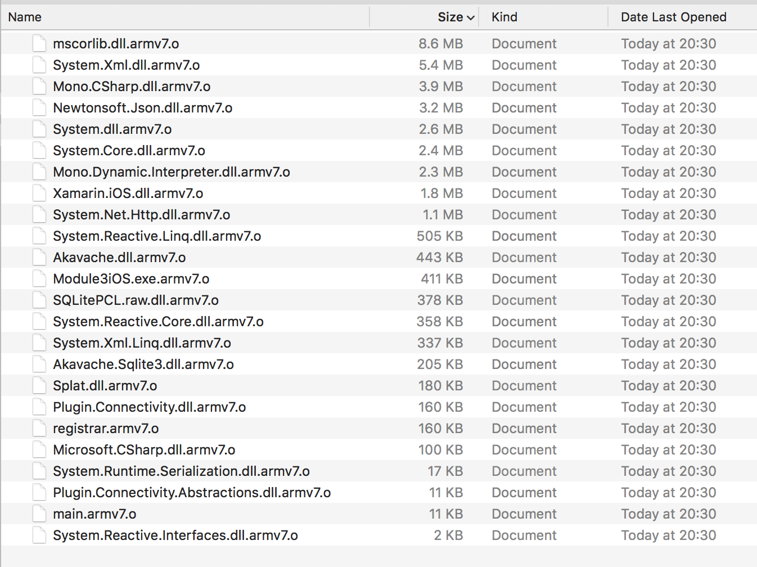
Good app

Slide 136
Troubleshooting and code reviews

Slide 137
Exercise 6: Troubleshooting (group exercise)
Scenario: Your team is working with a customer that needs to release their app to the stores this week. They have a large amount of indeterminate crashes on Android.
How would you approach engaging with the customer to resolve the issue?
Prepare to present your ideas to the class.

Slide 138
Troubleshooting and code reviews
Troubleshooting and code reviews can be distinct processes, or they can be combined
Often a troubleshooting project will require a code review to find the source of the problems
Both processes follow the same basic steps:
Gather information
Customer provides the assets (source code) or steps to repro the issue
Investigate the problem and offer a solution
Provide feedback to the customer

Slide 139
Step one: Gather information
Customer provides the source code and a bug report or a feature request.
This step can be tricky because the customer might not understand the foundation of the problem
Things to look at:
Does the intended app functionality make sense?
Are they using presentation frameworks? (e.g. MvvmCross)
Does the code use shared projects, PCLs, or a combination?
Are the projects properly structured and linked?
Are there unresolved dependencies?
Are there NuGet packages?
Is there dependency injection, inversion of control?
Are they using custom scripts or external tools?
Are there native bindings? If so how are they maintained?

Slide 140
Step two: Customer provides assets/steps to repro
Good/Better/Best
Good: customer provides all the details they know about the issue
Better: they give you a repro that reproduces the issue
Best: they provide the source code where the problem is occurring
the source code will show all the factors that might contribute to the problem, including those that they might not realize influence the issue within the code architecture
Notes:
Troubleshooting nearly always involves getting additional information from the client that is additive to the initial set they shared with you
Typical kinds of additional information:
The device—the exact device.
The OS version and + or – versions to make sure it is not happening on those as well
The Xcode version the Android API or Android code version.
Take the information and create the environment for you to start your investigation.
But don’t be surprised if you find you need to reach back out more than once to the client.
Be sure to let them know that it is a cyclical process to solve the problem—keep the open dialog

Slide 141
Step three: Investigate the problem and offer solutions
Keep in mind that:
The architecture around the problem may be the actual problem
The issue they are seeing could be a symptom of a larger issue in the code base
Ensure that what they are trying to do makes sense in terms of UI and UX
Does what they want the application to do make sense?
What could fixing the problem do to the rest of the code if it doesn’t make sense?
You may need to let them know if their UI/UX plans aren’t optimal
Offer solutions or ways to improve:
Performance and memory management
Error handling
Caching and persistence
Security
Reachability
Continuous monitoring – Visual Studio App Center, Google Analytics, etc.
Testing

Slide 142
Step four: Provide feedback to the customer
Ensure that your messaging is highly detailed and descriptive
Provide specific examples
Describe issues and offer potential fixes
For simple fixes, send them an example (e.g. a source code snippet)
For fixes that are more complicated, you may have to be involved in a deeper engagement. Examples include architectural issues and/or if they are trying to do something that doesn’t make sense.
Remember that this is often an iterative process

Slide 143
Q & A

Slide 144
Memory management

Slide 145
Memory management - Challenges
Memory management is not a trivial concern
It is both approach-dependent and can be platform-specific
Profiler results may be surprising, contrasting with intuition
Memory management under debugging doesn’t match memory management at runtime
This topic has the largest number of “gotchas” in practice

Slide 146
Memory management topics for Xamarin applications
Release IDisposable resources
Unsubscribe from events
Use weak references to prevent immortal objects
Optimize image resources
Reduce the size of the application
Garbage collection
Notes:
There are many techniques for increasing the performance of applications built with the Xamarin platform. Collectively these techniques can greatly reduce the amount of work being performed by a CPU, and the amount of memory consumed by an application.
We will cover:
Garbage Collection
Releasing iDisposable Resources
Unsubscribing from Events
Using Weak References to Prevent Immortal Objects
Optimizing Image Resources
Reducing the Size of the Application

Slide 147
Memory management
Look for memory leaks, large images, large objects graphs, wide scopes, cross-references, contexts that prevent the garbage collector from working properly
Qualify performance hogs or opportunities with profiling and instrumentation
Measure startup time, operation time, memory consumption, CPU profile, networking profile, I/O profile
Highlight that a solution that works well on one platform won’t necessarily perform equally well on others
Notes:
A good place to start, when you’re trying to get a sense for what’s happening with the code and where the problems are, is with profiling. It can help you pinpoint larger reaching problems. It’s often the first thing we do, whether we’re responding to a specific issue or doing a code review.
We run through the code in a Profiler to find such problems as misuse of concepts (such as async/await); not caching things, which can lead to long-running tasks and crashes; or bad user experience. Profiler lets you locate those things earlier rather than later.

Slide 148
Release IDisposable resources
Use the Dispose method to explicitly release resources
This is important for managing memory or resource intensive native resources (bitmaps, fonts, files, etc...)
Wrap the IDisposable object in a using statement
Wrap the call to Dispose in a try/finally block
Notes:
The IDisposable interface provides a mechanism for releasing resources. It provides a Dispose method that should be implemented to explicitly release resources. IDisposable is not a destructor, and should only be implemented in the following circumstances:
When the class owns unmanaged resources. Typical unmanaged resources that require releasing include files, streams, and network connections.
When the class owns managed IDisposable resources.
Type consumers can then call the IDisposable.Dispose implementation to free resources when the instance is no longer required. There are two approaches for achieving this:
By wrapping the IDisposable object in a using statement.
By wrapping the call to IDisposable.Dispose in a try/finally block.
NOTE: Keeping all of this in mind that Dispose doesn’t necessarily mean that everything gets freed at that very instance as it relies on the GC cycle for that

Slide 149
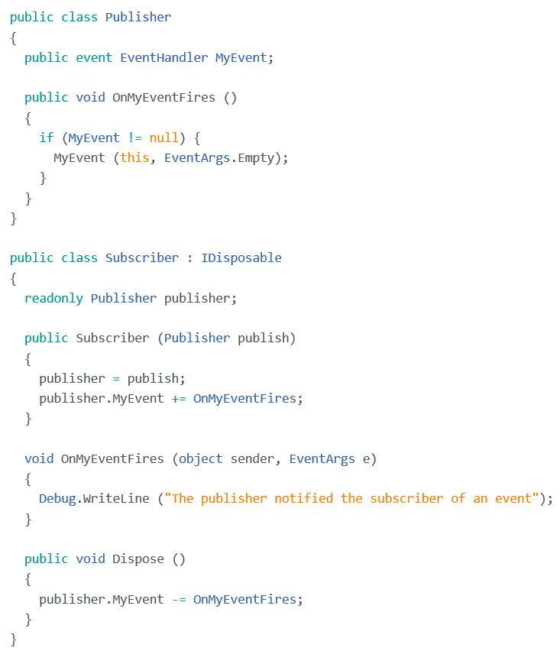
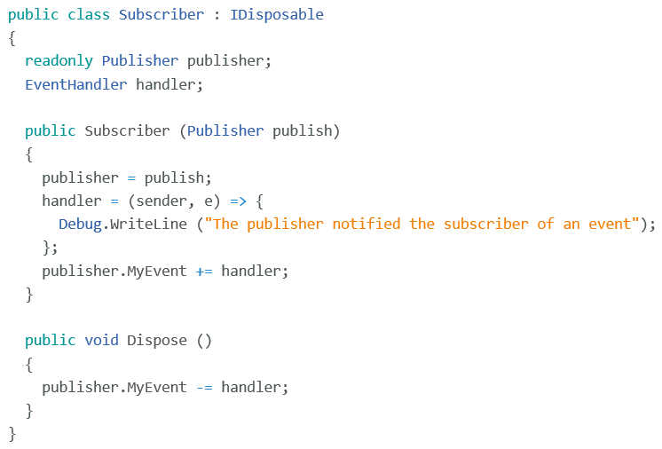
Unsubscribe from Events
Unsubscribe from events and avoid anonymous delegates to prevent memory leaks
A reference to the anonymous method can be stored in a field and used to unsubscribe from the event
Notes:
In order to prevent memory leaks
Events should be unsubscribed from before the subscriber object is disposed of
Until the event is unsubscribed from, the delegate for the event in the publishing object has a reference to the delegate that encapsulates the subscriber's event handler.
As long as the publishing object holds this reference, garbage collection will not reclaim the subscriber object memory.

Slide 150
Hidden memory leaks
The UIImageView will not be collected... Can you see why?
private void ShowWarning() { var imageView = new UIImageView(
UIImage.FromBundle("warning.jpg")) { Center = new CGPoint(View.Bounds.GetMidX(),
View.Bounds.GetMidY()) }; View.Add(imageView); // Wait 5 seconds and get rid of Image Timer warningTimer = new Timer(o => BeginInvokeOnMainThread(imageView.RemoveFromSuperview), null, 5000, Timeout.Infinite); }
Notes:
Here we are creating a new UIImageView
We add it into our visual tree so it's on the screen.
Then create a single-shot timer which expires 5 seconds in the future
When it expires, we remove the image from the screen.
Notice: we are not holding references to anything. All variables are scoped to this method.
That means when the GC kicks in, it should be able to collect the image view as there are no visible managed references and it's not in the iOS visual tree.
But.. The image view will not be collected. Ever. Anyone see the issue?

Slide 151
Breaking down the problem
Timer is passed a lambda expression, which removes the image…
private void ShowWarning() { var imageView = new UIImageView(
UIImage.FromBundle("warning.jpg")) { Center = new CGPoint(View.Bounds.GetMidX(), View.Bounds.GetMidY()) }; View.Add(imageView); // Wait 5 seconds and get rid of Image Timer warningTimer = new Timer(o => BeginInvokeOnMainThread(imageView.RemoveFromSuperview), null, 5000, Timeout.Infinite); }
Notes:
This particular issue is quite interesting because it's got several interesting things to it.
First, notice that our timer is being passed a lambda expression.
> This is essentially a delegate method written inline.
> The method itself is what is executed when the timer fires.
> It's passed a state object which we aren't using – that's the unused value here.
Remember our issue with delegates before? The same rules get applied here. But this one is tricky because the compiler does something interesting with lambdas

Slide 152
Breaking down the problem (further)
Lambdas are just a compiler trick – they really turn into full methods and often need to rewrite the code to capture state
private void ShowWarning() {
var a = new <ShowInitialWarning>c__AnonStorey0(); a.imageView = new UIImageView(...);
View.Add(a.imageView); Timer warningTimer = new Timer(a.<>m__0); null, 5000, Timeout.Infinite); }
[CompilerGenerated] private sealed class <ShowInitialWarning>c__AnonStorey0 { internal UIImageView imageView; internal MainController $this; internal void <>m__0(object unused) { this.$this.BeginInvokeOnMainThread(new Action(
this.imageView.RemoveFromSuperview)); } }
Image got moved into heap allocated class
Notes:
When the C# compiler encounters a lambda, it has to create a real method in a class to make it work. This is because lambdas are really just a shiny compiler trick – the runtime only knows about method delegates.
Here you can see what the compiler does to our code.
> Notice that it creates a new class, clearly not defined by us.
That class is compiler generated – created specifically to support and contain our lambda method.
> It's a class – meaning it's heap allocated and must be cleaned up by the GC.
> The important thing here is that the Image View is being lifted out of the method and placed into this class because the lambda method needs to access it.
> Finally, notice that our actual lambda method code is defined here.

Slide 153
The hidden reference
Timer creates a static list of running timer delegates that are called by a single thread, even if the timer only fires once
private void ShowWarning() {
var a = new <ShowInitialWarning>c__AnonStorey0(); a.imageView = new UIImageView(...);
View.Add(a.imageView); Timer warningTimer = new Timer(a.<>m__0, null, 5000, Timeout.Infinite); }
… and our lambda instance is passed to the timer ... held in a static list ... which means our object (and the image) stays alive forever!
Notes:
That in itself isn't necessarily bad – as long as we can clean up the little state object holding our image view we are ok.
The problem here is the Timer.
> We are using System.Threading.Timer which creates a single thread to manage a global timer list of callbacks. This was a poor choice.
> The list is held by a static internal field in the Timer class.
> Since we passed in our method instance, that delegate is now in the list.
> The static keeps the instance object rooted (meaning the GC cannot collect it)
> and the instance object keeps the Image View alive.
However, like before, the fix is very simple. In this case, the timer keeps the callback alive even for a single-shot timer because you can restart it.

Slide 154
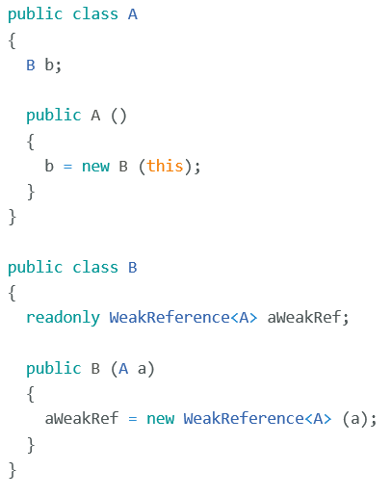

Use weak references to prevent immortal objects
This diagram illustrates a strong reference creating an unwanted immortal object
WeakReference code example
A desirable weak reference is created with the WeakReference type
Notes:
Garbage collectors manage the allocation and release of memory for your application.
Each time a new object is created, memory is allocated from the managed heap.
Eventually the garbage collector must perform a collection in order to free some memory.
When the garbage collector performs a collection, it examines objects in the managed heap to see if they are in use, and reclaims the memory of any unused objects.
If an application maintains a reference to an object, its memory cannot be reclaimed by the garbage collector. Such references are referred to as strong references.
In this example, both Object A and Object B have strong references to each. Due to the presence of the circular strong references these are known as immortal objects.
As a result, neither object can be reclaimed by the garbage collector, even if the objects are no longer in use by the application.
The solution to circular references is to replace one of the strong references with a weak reference. A weak reference references an object while still allowing that object to be reclaimed by garbage collection. The weak reference exists only during the unknown amount of time until the object is collected, assuming that any strong references have also been destroyed.
The WeakReference is created using the instance of the object to be tracked. Therefore, object A maintains a strong reference to object B, but object B maintains a weak reference to object A.
Avoid using a weak reference to small objects because the reference may be as large or larger than the object.
Weak references are useful for objects that use a lot of memory, but which can be recreated easily if they are reclaimed by garbage collection. For example, suppose that a frequently accessed page displays a high-resolution image. Keeping the image in memory is inefficient when the user navigates to other pages in the application. Therefore, when the user navigates to another page, a weak reference to the image could be created, with any strong references being destroyed. When the user returns to the image page, the application would attempt to obtain a reference to the image, and if successful, would avoid reloading and decoding the image.

Slide 155
Optimize image resources
Images typically require more CPU usage to decode the image and more memory to store the decoded image
Reduce the CPU usage and memory footprint by creating multiple resolution versions of stored images that are appropriate for the predicted display sizes
Caching
Use tools to ensure images are the optimum size.
Refer to the following resources for image guidelines by platform:
Android: https://docs.microsoft.com/en-us/xamarin/android/app-fundamentals/resources-in-android/resources-for-varying-screens
iOS: https://docs.microsoft.com/en-us/xamarin/ios/app-fundamentals/images-icons/app-icons
Notes:
Images are some of the most expensive resources that applications use, and are often captured at high resolutions.
While this creates vibrant images full of detail, applications that display such images typically require more CPU usage to decode the image and more memory to store the decoded image.
It is wasteful to decode a high resolution image in memory when it will be scaled down for display.
Solution, reduce the CPU usage and memory footprint by creating multiple resolution versions of stored images that are close to the predicted display sizes.
For example, an image displayed in a list view should most likely be a lower resolution than an image displayed at full-screen. In addition, scaled down versions of high resolution images can be loaded in order to efficiently display them with minimal memory impact. For more information, see Load Large Bitmaps Efficiently.
Issues I’ve ran into in the past:
- Images only in drawable (default to mdpi) folder – scaling up and down the size of the image
- Image rotations (via matrix) in Android
Regardless of the image resolution, displaying image resources can greatly increase the app's memory footprint. Therefore, they should only be created when required and should be released as soon as the application no longer requires them.

Slide 156
Image sizing: Tools and resources by platform
Mac and Windows: Adobe XD, Photoshop, GIMP, Inkscape, Figma
Mac only: Sketch App
https://sketchapp.com
Windows only: Lunacy
https://icons8.com/lunacy
Sketch App Sources offers free design resources and plugins. www.sketchappsources.com

Slide 157
Q & A

Slide 158
Additional resources
To learn more, refer to the following Xamarin University courses:
XAM370, Diagnosing Memory Management Issues
CSC271, Managing Non-Memory Resources

Slide 159
Profiling

Slide 160
General recommendations
Avoid profiling in a simulator—it can distort app performance
Allocation profiling is fine to do on the simulator
Time profiling portable code on the simulator is acceptable also but platform-specific code should be on a device
Perform profiling on a variety of devices
For best results, profile on the lowest end device available with latest OS version
Close all other apps to ensure that you’re measuring the full impact of the app you’re profiling rather than other apps
Notes:
The following best practices are recommended when profiling an app:
Avoid profiling an application in a simulator, as the simulator may distort the application performance.
Ideally, profiling should be performed on a variety of devices, as taking performance measurements on one device won't always show the performance characteristics of other devices. However, at a minimum, profiling should be performed on a device that has the lowest anticipated specification.
Close all other applications to ensure that the full impact of the application being profiled is being measured, rather than the other applications.

Slide 161
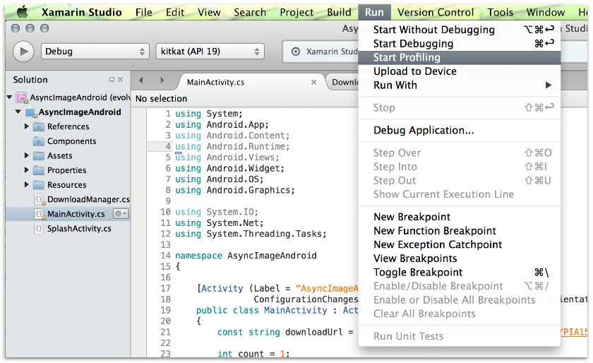
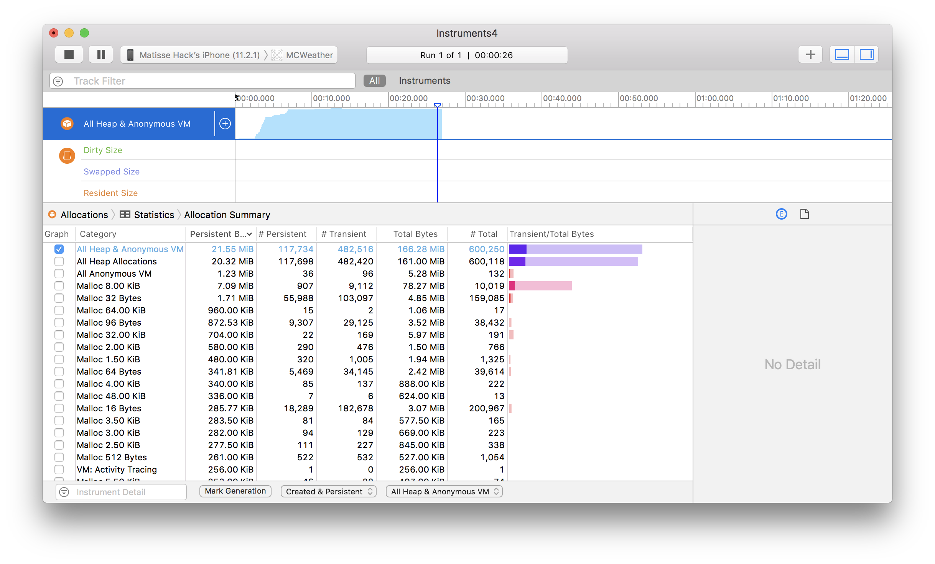
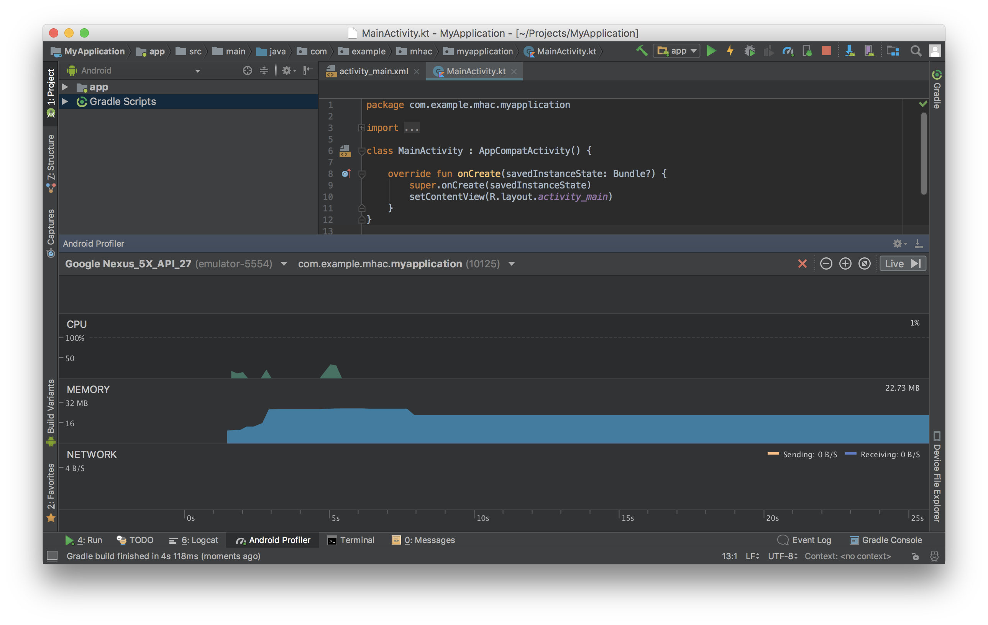
Profilers
Xamarin Profiler
Xcode Instruments
Android Studio Profiler
Notes:
https://developer.xamarin.com/guides/ios/deployment,_testing,_and_metrics/using_instruments_to_detect_native_leaks_using_markheap/

Slide 162
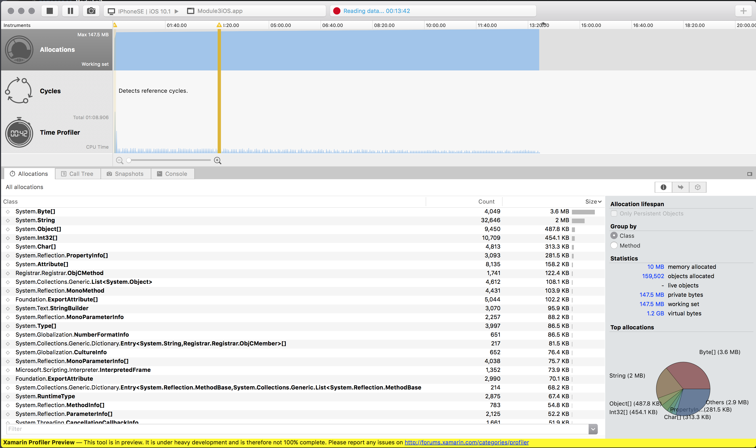
Xamarin Profiler
The Xamarin Profiler provides developers with a way to profile their Xamarin.Android and Xamarin.iOS applications from inside Xamarin Studio or Visual Studio.
www.xamarin.com/profiler
Timing
Allocations
Cycles
Notes:
Xamarin Profiler
The Xamarin Profiler provides developers with a way to profile their Xamarin.Android and Xamarin.iOS applications from inside Xamarin Studio or Visual Studio. The profiler collects and displays information about the app, which can then be used by the developer to analyze an application’s behavior. There are a number of different ways to profile an application with the Xamarin Profiler, namely memory profiling and statistical sampling. These are carried out through the Allocations and Time Profiler instruments respectively.
The Profiler shows
how CPU is allocated—which will reveal unneeded multiple instantiations of operations
How fast the code is running—and if the code is running slower than expected for the operation the reasons for this can be investigated and fixed

Slide 163
Exercise 7: Profile a mobile app
Scenario:
An app is experiencing crashes and slow performance. Use both the Xamarin Profiler and Instruments to both investigate and solve the problem.
Look for possible memory leaks, bottlenecks, and so on…
Note: This can be a team exercise. If you don’t have the Enterprise version of Visual Studio, pair up with someone who does.

Slide 164
Performance

Slide 165
Performance – General recommendations
Images
Caching
UI best practices – iOS, Android, Xamarin.Forms

Slide 166
Performance – iOS
Optimize table views
Reuse cells
Reduce number of sub views
Avoid image scaling and gradients
Be aware of constraint over-use
Optimize image sizes
Test on the widest possible variety of devices
Notes:
Forms and iOS
Forms are a great tool but it is important for developers new to mobile development to know how to use them efficiently.
Examples:
In iOS, reuse cells
Reduce sub views because too many is too bulky
Cache code that is complex and reusable. For example a view controller that isn’t going to change but is complex to build can be cached for reuse within the App and the cached version recalled instead of rebuilt.
Image scaling and gradients—which are fine for PC apps can create performance problems on mobile devices so avoid the in mobile apps.

Slide 167
Performance – Android
Optimize layout hierarchies
For example; Avoid unnecessary nested things like LinearLayout
Optimize image sizes
Test on the widest possible variety of devices
Minimize string measurements
Notes:
About Layout hierarchies in Android:
When thinking about layouts-- Keep It Simple Sam!
Your customers need to keep in mind they are building for mobile and even though there are lots of interesting things they can do with layouts.
if they don’t stay simple, they are likely to cause lots of problems in app performance
This is true of all parts of an Android App using layouts and images.
Put the images in the right place most efficiently accessible by the operation in the code
If the images in the folder are too big—can impact the memory so make sure they are the appropriate size for the use.
Test on a wide variety of devices for Android

Slide 168
Q & A

Slide 170
Appendix

Slide 171
Architectural choices

Slide 172
Architectural choices
Establishing a sense for the architectural pattern involves a series of questions and decision points. For example:
Should you use Xamarin.Forms or native?
Should you use Portable Class Libraries or Shared Projects?

Slide 173
When choosing between Forms or Native, first ask questions
Yes? Choose native!
Is this a consumer-facing app?
Forms sounds good
native!
Would my mom use this app?
Do you want similar UI on all platforms?
native!
Will the app require a lot of custom renderers?
Forms!
Is code reuse more important than pixel-perfect layout?
Are you targeting more than one platform?
Choose native!
Do you need to use a lot of native platform SDK features?
Yup, native!
Xamarin.Forms
Xamarin.iOS Xamarin.Android

Slide 174
Architectural design: What are Portable Libraries?
Portable Library: iOS/MAC/Android/.NET
Portable Libraries
(Simplified view)
.NET
Android
MAC
iOS
Portable Library: iOS/MAC
Portable Library: iOS/MAC/Android
Notes:
A key step to determining the build direction is for the Dev team to understand shared projects versus portable class libraries

Slide 175
Architectural design: Portable libraries vs. shared projects
Portable
Shared
Reasons for and implications of choices
iOS project
iOS project
Shared project
Shared project
Android project
Portable project
Android project
Shared project
Windows project
Windows project
Shared project
Notes:
When using the portable class library approach, the code in the device has separately compiled the native code and the shared code in different projects
When using the shared project approach, the shared project is really a container—ALL the code is in the container and the application uses the different kinds of code based on COMPILER DIRECTIVES
So, the portable class library (PCL) approach is easier because it is simpler—not so many compiler directives and so MUCH LESS COMPLEXITY in the code.
Also PCLs can be constructed and reused as components and shared across multiple apps. For example an enterprise could have a PCL for sending email and this could be used for all the Android apps being created

Slide 176
Architectural design: Complexity in a single app
In multi-platform development, every additional layer of code potentially requires a corresponding set of unit and UI tests

Slide 177
Architectural design: Complexity in multiple apps
Unit test
Unit test
Unit test
Common
iOS
Common PCLs
Common
Android
App 1
App 2
MyAPP
Portable Project
MyAPP
Portable Project
MyAPP
iOS
MyAPP
Android
MyAPP
iOS
MyAPP
Android
Notes:
As the number of apps increases, the complexity of related activities has to be taken into account and the consultant needs to be judge the capability of the client to be successful with this level of complexity

Slide 178
App 8
App 7
App 1
App 6
Complexity Increases
App 2
App 5
App 3
App 4

Slide 179
Unexpected advantage of complexity
Portable code can often be reused and repurposed for other apps and projects
For example:
UI-specific code in a PCL
Graphics-specific code in a PCL
Service-specific code in a PCL

Slide 180
Xamarin and Azure
Scale apps to millions of customers across multiple geographies
Add authentication, push notifications, and offline data sync quickly
Connect apps to enterprise systems, in the cloud or on premises
Use infinitely scalable storage to manage app resources
Build powerful apps with integrated tools, cloud services, and mobile SDKs
Integrate your mobile DevOps processes and systems with a few lines of code

Slide 181
Azure features of interest to Xamarin developers
User authentication. Enables single sign-on so users can authenticate with any cloud and on-premises app. Native support for five identity providers: Azure Active Directory, Facebook, Google, Microsoft Account, and Twitter, as well as your own custom identity solution.
Push notifications. Notification Hubs let your apps broadcast personalized push notifications to millions of users in minutes.
Storage and data connections. Azure Storage is massively scalable and accessible from anywhere and from any device.
Offline sync. Ensure your users can view, create, and modify data, even when they experience connectivity issues or are offline.
Cognitive services. Access next-generation cloud services with features like facial recognition, intelligent bots, visual search, and other kinds of exciting advanced functionality.
Mobile DevOps. Visual Studio, Azure, Xamarin Test Cloud, and HockeyApp provide a unified continuous integration and delivery solution that speeds up app delivery and boosts the productivity and quality of any mobile project.

Slide 182
Xamarin and Azure
Xamarin University Webinar Series
Connected Mobile Apps with Microsoft Azure
https://channel9.msdn.com/Events/Xamarin/Xamarin-University-Presents-Webinar-Series/Connected-Mobile-Apps-with-Microsoft-Azure
Azure Machine Learning for Developers
https://channel9.msdn.com/Events/Xamarin/Xamarin-University-Presents-Webinar-Series/Developers-Intro-to-Azure-Machine-Learning

Slide 183
Android device sizes
 | Low density ldpi .75x | Medium density mdpi 1x | TV density tvdpi 1.3x | High density hdpi 1.5x | Extra High density xhdpi 2x | XX High density xxhdpi 3x | XXX High density xxxhdpi 4x
Small
Normal |  | Galaxy S2 |  | Galaxy S3 | Galaxy S4 Nexus 4 | Galaxy S5 (3x) Nexus 5 (3x) Nexus 5x (2.6x) | Galaxy S6 (4x) Nexus 6P (3.5x)
Large |  | Galaxy Tab 8 | Nexus 7 (2013) | Galaxy Tab S8
Extra Large |  | Galaxy Tab 10 |  |  | Nexus 9 Nexus 10

Slide 184
Debugging some common sources of failure
Here are some common problems and how to start looking for solutions
Performance
Start by checking profiler to find hotspots
Threading
Sometimes clients don’t fully understand the differences between front and background code threads. The solution will be in the differences between the threads
The general architecture problems are of course bigger. Sometimes that is where you will have to look.

Slide 185
Reduce web service communication—bandwidth utilization
Connecting to a web service from an application can have an impact on application performance
Compress data before transferring it over a network
Recommendation: Use data transfer objects (DTOs) when transferring data between an application and a web service
Use async/await for executing the request and interpreting the response in the background
Cache the responses when possible
Basically web service calls need to have as small as footprints as possible
Fusillade
Notes:
Bandwidth utilization
Because connecting to a web service can have an impact on application performance, it's sensible to limit the bandwidth utilization.
Two examples of impacts
Increased usage of the device's battery.
Decreased performance in in a bandwidth limited environment.
Compressing data is one approach to reducing an application's bandwidth utilization
But, the additional CPU usage from the compression process can also result in an increased battery usage. So carefully evaluate this tradeoff before deciding whether to move compressed data over a network.
Data formats and bandwidth utilization.
Primary formats are:
Extensible Markup Language. XML is a text-based data-interchange format that produces relatively large data payloads, because it contains a large number of formatting characters.
JavaScript Object Notation. JSON is a text-based data-interchange format that produces compact data payloads, which results in reduced bandwidth requirements when sending data and receiving data.
Because of the reduced data payloads JSON is often the preferred format for mobile applications.
Data transfer objects and bandwidth utilization
It's recommended to use data transfer objects (DTOs) when transferring data between an application and a web service. A DTO contains a set of data for transferring across the network. By utilizing DTOs, more data can be transmitted in a single remote call, which can help to reduce the number of remote calls made by the application.
Generally, a remote call carrying a larger data payload takes a similar amount of time as a call that only carries a small data payload.
Data caching and bandwidth utilization
Data retrieved from the web service should be cached locally, with the cached data being utilized rather than repeatedly retrieved from the web service.
When adopting this approach a suitable caching strategy should also be implemented in order to update data in the local cache if it changes in the web service.

